Slide 1

2025 Endeavour Fund - End of year wrap-up
September 2025

Slide 2
What is the Endeavour Fund?
Open, contestable fund that supports excellent science in a wide range of areas
Supports research, science or technology, or related activities that have high potential to positively transform New Zealand’s economic, environmental, and societal outcomes and give effect to the Vision Mātauranga policy, where applicable

Slide 3
Investment Plan 2025-2027
The Endeavour Fund supports research, science or technology, or related activities that have
high potential to positively transform New Zealand’s economic, environmental, and societal outcomes,
give effect to the Vision Mātauranga policy where applicable, and
drive an increasing focus on excellent research and the potential for impact in areas of future value, growth or critical need for New Zealand.
The Science Board will also look for opportunities to fund proposals that:
enable wealth creation through developing new knowledge that lifts New Zealand’s economic performance (including an uplift in commercialisation), supports adaptation to climate change, builds a resilient and prosperous society
support growth of our base of innovative, high value exporting technology firms
Source: https://www.mbie.govt.nz/science-and-technology/science-and-innovation/funding-information-and-opportunities/investment-funds/endeavour-fund/smart-ideas-call-for-proposals-2025-investment-round-endeavour-fund

Slide 4
Gazette Notice – 2025 Investment Round
Smart Ideas are intended to catalyse and rapidly test promising, innovative research ideas with high potential for benefit to New Zealand, to enable refresh and diversity in the science portfolio.
Proposals may request funding ranging from $0.4 to $1 million, with project durations of 2 to 3 years.
Research Programmes is intended to support ambitious, excellent, and well-defined research ideas which collectively have credible and high potential to positively transform New Zealand’s future in areas of future value, growth, or critical need.
Proposals may request funding for at least $0.5 million/year, with project durations of 3 to 5 years.
Funding available up to $55 million (excl. GST). Indicative split:
$17 million (excl. GST) for Smart Ideas
$38 million (excl. GST) for Research Programmes
Science Board aims to fund at least
47 Smart Ideas
17 Research Programmes

Slide 5
Main changes implemented for the 2025 investment round
Smart Ideas
Transitioned from a two-step application and assessment process to a streamlined single-step procedure
Implemented an organisational cap on the number of applications per organization
Adjusted the timeline, with Smart Ideas decisions now announced in June instead of September
Lowered costs and reduced workload demands
The Smart Ideas pilot received overall positive feedback from both applicant organisations and assessors
​
Research Programmes
Removed the impact categories “Protect and Add Value” and “Transform”

Slide 6
Funding decision
Funding decision is made by the Science Board https://www.mbie.govt.nz/about/who-we-are/our-external-boards/our-science-board
Decision is based on the Gazette notice for the Endeavour Fund 2025 Investment Round https://gazette.govt.nz/notice/id/2024-go2942
Alignment with the Endeavour Fund Investment Plan 2025-2027 https://www.mbie.govt.nz/science-and-technology/science-and-innovation/funding-information-and-opportunities/investment-funds/endeavour-fund/investment-plan-2025-2027-transforming-new-zealands-future

Slide 7
Funding decision
Smart Ideas (May 2025)
Typically invest in the best proposals based on a rank-order list (total mean weighted scores).
Portfolio approach applied this year for two equal score Smart Ideas that were held in reserve until Research Programmes funding decision
Research Programmes (August 2025)
Sufficient merit (total mean weighted scores)
Take a portfolio approach
Consider how the overall mix of investments meet the investment signals in the Investment Plan
Consider value offered by the largest Research Programmes proposals
Duplication or Concentration: avoid duplication and excessive concentration in Endeavour and in the broader public science system (review sectors of the existing portfolio with high investment)
Meeting policy objectives including the Vision Mātauranga policy, if applicable

Slide 8
Overall summary
Quality of applications continues to be very high across Smart Ideas and Research Programmes
Total submission of 323 proposals
169 Smart Ideas with 161 going through assessment. The Science Board decided on eight Smart Ideas not being eligible before going through assessment, and another seven post assessment;
154 Research Programmes proposals were assessed, with one not being eligible;
covering a wide breadth of disciplines.
Significant increase in number of Smart Ideas applications from new organisations, therefore Science Board met to decide on eligibility of proposals before going through assessment. The Science Board re-reviews eligibility after assessment.
Largest Research Programmes proposal requested $2.93 million/p.a., and largest Research Programmes proposal funded was $2.47 million/p.a.

Slide 9
Smart Ideas
2025 Endeavour Round - Smart Ideas in numbers

Slide 10
Smart Ideas - reflection
Implementation of organisation cap and submission of proposals went smoothly
MBIE aimed for 150 Smart Ideas proposal submissions and received 169 submissions
Increased number of new organisation submitting a proposal
After an initial assessment and decision on eligibility by the Science Board, 8 proposals were found to be ineligible and therefore 161 proposals went through assessment.
The top areas with high requests for investment were:
-Manufacturing (15.8%)
-Primary Production (14.3%)
-Natural Hazards (8.5%)

Slide 11
Smart Ideas - funding
The Science Board decided to fund 46 Smart Ideas (May 2025) and to put 2 equal score Smart Ideas proposals in reserve, to be included in the Research Programmes funding decision (August 2025).
The Science Board applied portfolio balancing criteria to fund 1 additional Smart Ideas proposal at the August Science Board decision meeting. Therefore a total of 47 Smart Ideas received funding in the 2025 investment round.

Slide 12
Smart Ideas breakdown by SEO (socio-economic objectives) categories
SEO category | Target (%) | Submission (%) n=161* | Funded (%) n=47 | Current spread across Smart Ideas (%) | Current spread across Endeavour Fund (%)
Economic | 70.0 | 74.6 | 75.0 | 77.3 | 74.3
Environmental | 25.0 | 13.3 | 17.7 | 14.8 | 15.6
Societal | 5.0 | 10.7 | 5.6 | 6.1 | 9.5
Other | 0.0 | 1.4 | 1.7 | 1.8 | 0.6
More information on https://www.mbie.govt.nz/science-and-technology/science-and-innovation/research-and-data/successful-funding-application-anzsrc-data/
*Smart Ideas going through assessment

Slide 13
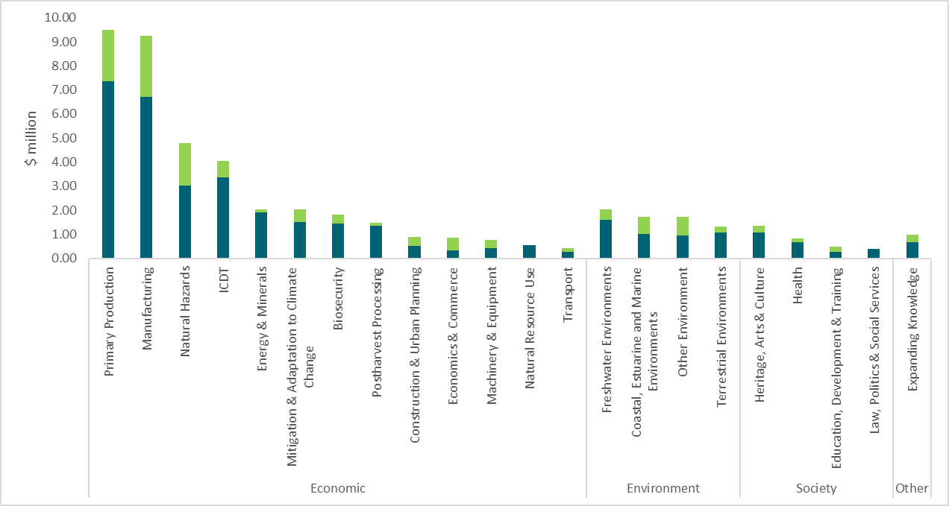
SEO breakdown: existing commitments (dark green) and 2025 investment (bright green)

Slide 14
Submission rate by organisation (Smart Ideas)
Organisation type | Submitted for assessment (%) | # funded proposals | Proportion of funded proposals (%)
Tertiary institutes | 56.5 | 27 | 57.4
Public Research Organisations (PROs) | 19.3 | 11 | 23.4
Independent research organisations | 6.8 | 3 | 6.4
Organisations classified as Other | 17.4 | 6 | 12.7

Slide 15
Success rates over time (Smart Ideas)
Investment round | Number submitted for assessment | Number funded (success rates) | Annual value of new investment (million)
2017 | 250 | 41 (16.4%) | $15.4
2018 | 254 | 47 (18.5%) | $16.6
2019 | 282 | 49 (17.4%) | $17.2
2020* | 309 | 0 | 0
2021 | 416 | 52 (12.5%) | $18.5
2022 | 331 | 51 (15.4%) | $17.8
2023 | 316 | 49 (15.5%) | $17.2
2024 | 351 | 53 (15.1%) | $18.2
2025** | 161 | 47 (27.8%) | $17.0
* COVID-affected round – no SI funded
** Move from two stage submission process to one stage and introduced organisational cap.

Slide 16
Comparing organisations with successful Smart Ideas proposals over the previous 4 years

Slide 17
Comparing organisations with successful Smart Ideas proposals (%) over the previous 4 years

Slide 18
Research Programmes
2025 Endeavour Round – Research Programmes in numbers

Slide 19
Research Programmes - reflection
MBIE received 154 submissions
Only one proposal was not eligible for funding according to the 2025 Endeavour Fund Gazette notice
Largest request for funding was $2.93 million/p.a
Fewer proposals asking for a large amount of funding than 2024
A high proportion of proposals in the area of Primary production in the 2025 Investment round
Funding in the economic SEO category exceeded target of 70%, with funding for both environmental and societal SEO categories below their respective targets
The full portfolio is still over-invested in the societal SEO category
The top areas with high requests for investment were:
-Primary production (16.9%)
-Manufacturing (11.1%)
-Energy and Minerals (7.7%)

Slide 20
2025 Research Programmes breakdown by SEO (socio-economic objectives) categories
SEO categories | Target (%) | Submission (%) n=154 | Funded (%) n=19 | Current spread across Research Programmes (%) | Current spread across Endeavour Fund (%)
Economic | 70.0 | 74.7 | 80.0 | 73.2 | 74.3
Environmental | 25.0 | 15.2 | 17.5 | 15.9 | 15.6
Societal | 5.0 | 8.0 | 2.5 | 10.7 | 9.5
Expanding Knowledge | 0.0 | 2.0 | 0.7 | 0.2 | 0.6
More information on https://www.mbie.govt.nz/science-and-technology/science-and-innovation/research-and-data/successful-funding-application-anzsrc-data/

Slide 21
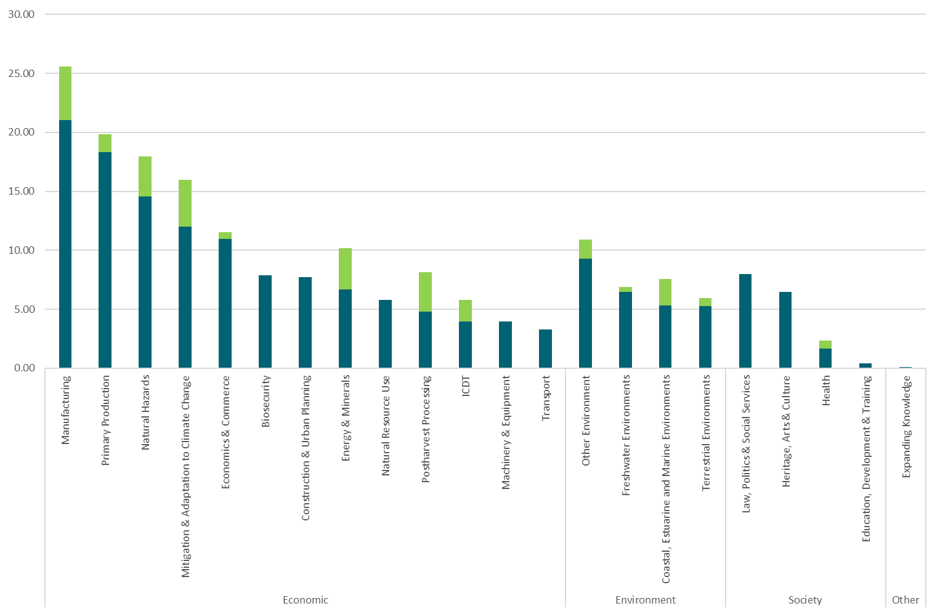
SEO breakdown: existing commitments (dark green) and 2025 investment (bright green)

Slide 22
Submission rate by organisation (Research Programmes)
Organisation type | Submitted for assessment (%) | # funded proposals | Proportion of funded proposals (%)
Tertiary institutes | 78 | 11 | 57.9
Public Research Organisations (PROs) | 47 | 7 | 36.8
Independent research organisations | 17 | 1 | 5.3
Organisations classified as Other | 12 | 0 | 0.0

Slide 23
Success rates over time (Research Programmes)
Investment round | Number submitted for assessment | Number funded (success rates) | Annual value of new investment ($ million)
2017 | 158 | 27 (17.1%) | 42.6
2018 | 145 | 23 (15.9%) | 41.3
2019 | 131 | 22 (16.8%) | 39.2
2020 | 128 | 17 (13.3%) | 38.0
2021 | 128 | 17 (13.3%) | 38.4
2022 | 112 | 20 (17.9%) | 38.2
2023 | 106 | 19 (17.9%) | 39.9
2024 | 137 | 19 (13.9%) | 38.2
2025 | 154 | 19 (12.3%) | 37.8

Slide 24
Additional information

Slide 25
Smart Ideas – Pilot survey
Applicants: Response rate - 55%
Assessors: Response rate - 33%
Both applicants and assessor felt there was timely and sufficient guidance given for proposals and assessments, respectively
The majority of assessors felt comfortable with assessing both Excellence and Impact; the majority of returning assessors even preferred the combined assessment

Slide 26


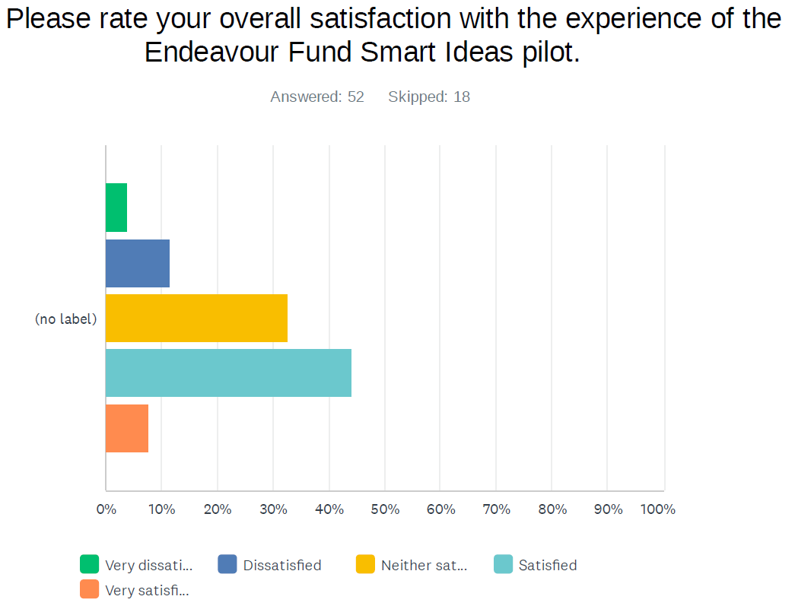
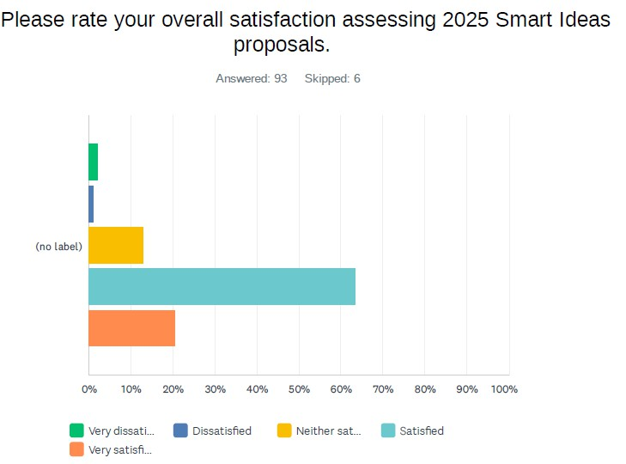
Smart Ideas - Pilot survey – applicant and assessor experience
Overall, applicants and assessors were satisfied with the one stage Smart Ideas process
Applicant responses
Assessor responses

Slide 27
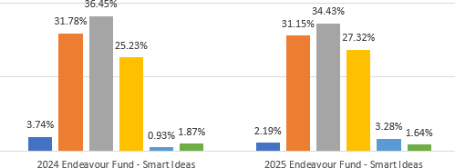
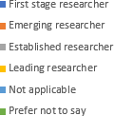
Endeavour Smart Ideas applications by career stage (MBIE analysis)
There was initial concern that early career researchers will get disadvantaged when introducing an organizational cap for the 2025 investment round.
MBIE compared 2024 and 2025 investment rounds, and the graphics below show minimal changes across career stages, with Emerging researchers still representing a large proportion of applicants

Slide 28
Thank you.
Contact: endeavour@mbie.govt.nz
Ministry of Business, Innovation & Employment www.mbie.govt.nz

