Slide 1
Consumer Problems
Combined quantitative and qualitative report
December 2017

Slide 2
TABLE OF CONTENTS
EXECUTIVE SUMMARY
BACKGROUND AND OBJECTIVES
METHODOLOGY
KNOWLEDGE OF CONSUMER RIGHTS AND THE CONSUMER GUARANTEES ACT
PROBLEM TYPES, PREVALENCE, AND COST
CONSUMER RESPONSE TO PROBLEMS
PROBLEM TYPES – QUICK PROFILES
PERCEPTIONS OF REASONABLE PRODUCT LIFE
APPENDIX A: SURVEY QUESTIONNAIRE
APPENDIX B: SAMPLE PROFILES
APPENDIX C: QUALITATIVE MATERIALS
APPENDIX D: CONSUMER STORIES
3
10
11
13
19
26
41
93
96
104
109
115

Slide 3
Executive summary

Slide 4
EXECUTIVE SUMMARY (1)
The first objective of the research was to gauge consumers’ awareness and understanding of their rights and the Consumer Guarantees Act (CGA). The key findings related to this objective are highlighted below.
67%
think they have at least a moderate understanding of consumer rights
Consumers tend to rate their own knowledge highly
81%
think they have at least a moderate understanding of the CGA
Those who think they have a higher knowledge are not significantly better at answering CGA true/false scenarios than others
But high perceived knowledge doesn’t mean they actually know a lot about the CGA
✓
X
Fewer than half of consumers recognise when they would be entitled to:
pay a reduced amount for plumbing work carried out inadequately
a partial refund from a mechanic when a repair was carried out inadequately
refuse to pay an exorbitant price for moving services (where a price was not agreed beforehand)
There appears to be a lack of knowledge around how the guarantees relate to services…

Slide 5
EXECUTIVE SUMMARY (2)
The second objective of the research was to understand the problems people encounter, the frequency of them, the barriers and motivators for action. The key findings related to the second objective are highlighted on this and the following pages.
MOTIVATION TO ACT
BARRIERS TO ACTION
RESOLUTION
PROBLEMS
73%
of consumers have experienced a problem with a product or service in the past two years
Sectors where the problems are high impact on at least one dimension
HIGH INCIDENCE
HIGH VALUE
Personal products
We used three dimensions to assess the relative impact of problems by sector to help MBIE prioritise sectors. The dimensions were: (1) incidence of problems, (2) value of problems (how much problems cost consumers to resolve), and (3) effort taken to resolve problems.
No sector has problems which are, on average, high impact on all three dimensions. However, some sectors were high impact on two dimensions (high incidence and high effort to resolve; or high value and high effort). These sectors are highlighted in the venn diagram to the right – note only those sectors which have problems which are high impact on at least one dimension are shown.
Electronics or electrical products
Motor vehicles sales
Food or drink
Fixed-line telecoms services
Construction & trades
Banking & financial
Recreation or leisure activities
Professional or technical services
HIGH EFFORT

Slide 6
EXECUTIVE SUMMARY (3)
MOTIVATION TO ACT
BARRIERS TO ACTION
RESOLUTION
PROBLEMS
79%
…the proportion of problems consumers take action to resolve
Motivation to act is dependent on a variety of factors…
Action is also contingent on the presence of certain practical factors:
AVAILABILITY OF PERSONAL RESOURCES
The consumer feels empowered to act – they have the requisite time, knowledge, and enthusiasm
Clarity on the failure e.g. the exact nature of the problem.
Existence of evidence such as documentation (e.g. contract, quote), photographs, witnesses.
A definite sense of what is being demanded of the service provider for a resolution / the desired outcome / the remedy.
SUBSTANTIAL PERSONAL IMPACT
The problem has a real effect on the consumer’s life
RELATIVE $-VALUE, PERSONAL ‘COST’
The money value of the issue is significant and worth the time and effort to resolve
+
DESIRE TO TAKE A STAND
Consumer is driven to ‘stick up for themself’ or consumers generally
BELIEF IN LIKELIHOOD TO SUCCEED
They are confident in the likelihood of a positive outcome
ACCESS TO KNOWLEDGE, VALIDATION, PEER OR PROFESSIONAL ‘EXPERTISE’
The opportunity to corroborate and validate that the issue is actually a problem
This knowledge gap prevents consumers from taking action across the sectors

Slide 7
EXECUTIVE SUMMARY (4)
MOTIVATION TO ACT
BARRIERS TO ACTION
RESOLUTION
PROBLEMS
21%
…the proportion of problems consumers do not take action to resolve
A combination of obstacles may prevent consumers from acting, including…
Relative dollar value and lack of knowledge were the most frequently mentioned problems barriers (at least at a rational level). One of the greatest knowledge barriers was a lack of knowing what process to follow once they had initially been rebuffed by the vendor.
The relative dollar value of the product/service is not worth the time involved
They are overwhelmed by the thought of ‘building a case’ against the seller
They lack the knowledge required
The personal (emotional) cost is too high
It was cheap/discounted already so they don’t feel they have the right to complain
Health products
Professional or technical services
Recreation or leisure activities
Health services
Consumers are least likely to take action
to resolve problems with…

Slide 8
EXECUTIVE SUMMARY (5)
MOTIVATION TO ACT
BARRIERS TO ACTION
RESOLUTION
PROBLEMS
82%
problems are resolved to the satisfaction of the consumer when they contact the vendor/manufacturer
(most received a refund, repair or replacement)
3% are still being resolved and likely to be resolved 2% are unlikely to be resolved
There are a number of reasons why problems may not be resolved to the satisfaction of the consumer, including…
Rude or unsympathetic attitude on the part of the seller, provider, or tradesperson
Fault or problem was not not completely fixed, or done poorly
It took too long to resolve, a lot of contact was required
A variety of other reasons as to why the remedy was inadequate
% the seller, provider, or tradesperson did nothing when contacted
14%
16%
Products
20%
Services
of problems are resolved, but not to the satisfaction of the consumer

Slide 9
Introduction and method

Slide 10
BACKGROUND AND OBJECTIVEs
MBIE data relating to consumer enquiries identifies the Consumer Guarantees Act (CGA) as the most enquired-about area.
Data also suggests that consumers are less certain about the role the CGA plays in relation to services, compared to goods.
In 2016, MBIE commissioned Colmar Brunton to carry out the National Consumer Survey. This highlighted industry sectors where consumers frequently encounter problems. MBIE wanted to know more about consumers’ awareness and understanding of consumer rights, their experiences with problems, and their behaviours when dealing with problems.
Aims of this research include:
1
Gauge consumers’ awareness and understanding of their rights and the CGA
Understand what problems consumers encounter, how common they are, whether or not they take action to resolve the problems, why or why not, any motivations or barriers for acting or not acting
Gain a deeper understanding of problems/issues by sector, with a focus on services
2
3

Slide 11
Survey METHODOLOGY
1,500 CONSUMERS SURVEYED
DATA WEIGHTED TO BE REPRESENTATIVE OF NZ
ONLINE INTERVIEWS
This includes:
a nationally representative sample of 1,000 consumers,
plus a ‘booster’ sample of 500 consumers who had experienced at least one consumer problem in the past two years.
Consumers who had experienced at least one problem were asked about a maximum of two of them.
Conducted via Colmar Brunton’s panel from 19 July to 7 August 2017
The final sample was weighted to Statistics New Zealand population counts to be nationally representative by age, gender, and location.
A detailed sample profile is supplied in Appendix B.
FOCUS ON PROBLEMS WITH PRODUCTS AND SERVICES
?
The questionnaire was drafted by Colmar Brunton in close consultation with MBIE. The full questionnaire is provided in Appendix A.

Slide 12
QUALITATIVE METHODOLOGY
6
6
2
FACE TO FACE IN-DEPTH INTERVIEWS
TELEPHONE INTERVIEWS
WORKSHOPS
*
*
*
4 X PEOPLE WHO DID NOT TAKE ACTION
6 X PEOPLE WHO TOOK ACTION
CONSUMER JOURNEY WORKSHOPS IN ‘PROBLEM SECTORS’
Defined as those with consumer protection issue but have barrier to action (identified in preceding quant phase as: no time, unsure where to go for advice, or what action to take, had concerns about jeopardising relationship with supplier, didn’t think doing something would resolve the issue, have tried to resolve problems in the past and have been unsuccessful, or didn’t want any confrontation)
Building and Contracts were identified as 2 ‘problem sectors’ from the survey. Customer journey creation workshops were undertaken in Auckland. While the outcome of the workshops was to develop customer journey maps, overall learnings from the discussions are woven into the qualitative findings.
Specific considerations as follows:
2 x who first sought out information about their rights
2 x whose issue is not resolved to satisfaction or unlikely to be resolved
2 x whose issue was resolved but had to put a lot of effort in
FOCUS ON SERVICES ISSUES
2 X CONSUMERS WITH LOW KNOWLEDGE WHO TOOK ACTION
Within two problem sector areas, included a mix of participants with the following characteristics:
Defined as those with low knowledge but took some form of action to resolve their problem
TOOK ACTION…
NOTE: Interviewees were identified in the survey and screened for further participation via telephone recruitment. The majority of participants self-identified as moderate & low knowledge around their rights/CGA (1 identified as high). No information regarding consumer protection was provided to interviewees in preparation for the interview; the emphasis was on their experience / problem and the invitation was to discuss their story. Telephone interviewees were required to do a pre-task (populate a template) to map their problem experience for reference in the interview..
…but not resolved to their satisfaction
…but the seller did nothing
…and satisfactorily resolved
…and had to put in a lot of effort to resolve the problem
RECRUITED OFF THE PRECEDING QUANTITATIVE SURVEY PHASE
MIX OF AGE
ROUGHLY EVEN SPLIT OF GENDER ACROSS ALL
INTERVIEWS & WORKSHOPS TOOK PLACE DURING SEPTEMBER, OCTOBER 2017
FACE TO FACE INTERVIEWS: AUCKLAND (MAJORITY) AND WELLINGTON
WORKSHOPS: AUCKLAND
TELEPHONE INTERVIEWS: NATIONWIDE (VARIOUS)
* See Appendix C for topic guides and materials. Detailed consumer stories gathered in the research are provided in Appendix D.

Slide 13
Knowledge of consumer rights and the Consumer Guarantees Act

Slide 14
Self-Stated knowledge
Two-thirds (67%) of consumers think they know at least a moderate amount about their consumer rights and most (81%) believe they have at least a moderate understanding of the Consumer Guarantees Act itself.
Self-stated knowledge of consumer rights
%
Nett 67%
Self-stated knowledge of the Consumer Guarantees Act
Young people aged 18-26 are more likely than average to say they have a high level of knowledge about the CGA (rating a ‘4’ or ‘5’ out of 5) – 34% compared to 24% on average.
%
Nett 81%
Base: All consumers (n=1,000) Source: Q1_S1, Q1_S2
Notes:
(51% know at least a moderate amount about their consumer rights in NCS).
(65% have at least a moderate understanding of CGA in NCS).
Those more likely to know at least a moderate amount about consumer rights include:
Men 71% (c.f. 64% of women)

Slide 15
HOW MUCH DO PEOPLE ACTUALLY KNOW?
Most consumers (87%) know that sellers are obliged to replace, refund, or repair faulty products, regardless of whether they were discounted or not. But consumers appear to have a lower level of knowledge around how the guarantees relate to services, as well as whether the guarantees would apply after a warranty has run out.
True or false?
% who were correct
If you buy something on sale at a discounted price and then you find it’s faulty – the shopkeeper has to replace, refund or repair it
If you arrange for an electrician to install some new lights in your home and they do some extra work he/she thinks is necessary without asking you first, you still have to pay for that work
While a builder is installing a new window in your home you accidently drop a hammer onto it and it cracks. You are entitled to a remedy under the Consumer Guarantees Act
You hire a plumber to fix several burst pipes for a fixed cost. After the plumber finishes one of the pipes is still leaking. You have the right to pay a reduced amount
You notice an oil leak shortly after having your car fully serviced. You go to a different mechanic to get the leak fixed. You have the right to a partial refund from the first mechanic for not properly completing the original service
If your fridge breaks down a month or so after the manufacturer’s 12 month warranty has run out, the store still has to repair it free of charge
You hire a moving service, without first being given the rates. After the move, you see that the invoiced amount is three times higher than any competitor’s rate for the same service. You must pay the full cost as the service was already carried out
To assess how well consumers’ perceived knowledge matches their actual knowledge, MBIE crafted some consumer problem scenarios.
Respondents had to indicate whether they thought each statement was true or false.
Base: All consumers (n=1,000)
Source: Q3

Slide 16
Number of true or false Scenarios correct
Most consumers have some knowledge of their rights under the CGA (73% answer 3 to 5 scenarios correctly), but very few have complete knowledge – 6% answer 6 or 7 scenarios correctly.
Number of scenarios answered correctly
%
Nett 6-7
6%
CONSUMERS’ WHO ARE CONFIDENT IN THEIR KNOWLEDGE MAY NOT ACTUALLY KNOW MORE
Those who think they have a good understanding answer the scenarios about as well as those who think they know less. They are only slightly more likely to answer all of the scenarios correctly.
Nett 0-2
20%
 | Perceived knowledge of CGA
Number correct | Know a little or know nothing % | Know a lot or a moderate amount %
0-2 | 28 | 18
3-5 | 71 | 75
6-7 | 1 | 7
Nett 3-5 73%
= Significantly higher/lower than those with less than moderate perceived knowledge of the CGA
Base: All consumers (n=1,000)
Source: Q3_S1

Slide 17
CONSUMERS LACK KNOWLEDGE AROUND HOW THE CGA IS APPLIED
While awareness of consumer rights and the Consumer Guarantees Act is high, specific knowledge of guarantees and their application is limited.
“I don’t really know much about the CGA. I never looked it up. But it’s pretty obvious you know? I mean I know I have rights to get what I paid for and [the supplier] can’t just get away with not giving me my internet. So I just kept at it.”
Male, 36-50 years, Hamilton
“It is the legislation that ensures fairness, that ensures goods and services are bona fide and protects the consumer. It upholds your rights and allows you to complain, seek recourse.”
Female, 51-64 years, Auckland
“I know I have rights. I know the CGA exists. I don’t know the details, but I know I could find it if I ever had a need for it.”
Female, 36-50 years, Auckland
“Words like ‘available’ and ‘reasonable’ used in the guarantees. I don’t know. I wouldn’t know about reasonable. And what does it mean – one person’s idea of ‘available’ is not mine.” Male, 31, Auckland
People are aware of the CGA above any other single piece of consumer protection legislation.
In this context of a general baseline of awareness of “rights” those who are not aware of the specifics of the CGA still understand that there are protections. However it is in the application of these protections that the lack of knowledge manifests. For some it is as simple as “I don’t know what to do”, for others it can reflect I don’t know what it means in practice.
People are especially unsure when services are involved, express uncertainty around weight and applicability of the CGA and its guarantees relative to interpreting wording in a specific agreement / contracts and people question whether some guarantees are too vague, unquantifiable and too “open to interpretation”.

Slide 18
SOURCES OF INFORMATION ABOUT CONSUMER RIGHTS AND THE CGA
Awareness of consumer rights and the Consumer Guarantees Act is mainly derived through peers, media, and lived experience.
Experiences shared, anecdotes, own encounters and everyday life are common ways in which awareness of consumer rights and the CGA is raised
A smaller number of people specifically learn about the CGA as part of coursework at school / tertiary study and for some through training and experiences in their workplace
Consumer-focussed TV shows (‘Fair Go’) are mentioned very frequently as sources of general awareness and specific learning of consumer rights and the CGA; for a small number it prompted further research online into consumer rights and the Act specifically
The organisation ‘Consumer NZ’, its website and publications (magazine) are referred to as credible sources of information, however the subscription-based nature of the organisation and the paywall on the website is a frustration and a barrier for information seekers who want a shortcut to a simple, credible explanation
Some refer to seeing CGA-related information on signs in shops, banks, detailed on receipts (cited regarding returns), contracts, invoices and purchase-related documentation – a casual encounter for most consumers who do not seek it out, it was considered to perhaps be a legal requirement, a reminder or just to ‘cover’ a supplier/provider
“I remembered reading about how companies try to ignore you and hope you go away in that magazine, Consumer. So I was like maybe I’ll write to them about this. I had emailed and called [the supplier] and still no reply so I was getting pretty annoyed.” Female, 51-65 years, Waikato
“It is good common sense in New Zealand because we have been brought up on shows like Fair Go. Since a kid - growing up – you watch and learn and you know it exists. You don’t have to know every detail to know it is there and gives me the right to stand up for myself.” Female, 36-50 years, Auckland

Slide 19
Problem types, prevalence, and cost

Slide 20
Overall prevalence of problems
The survey found that 73% of consumers had experienced at least one problem with a product or service in the past two years.
The following pages include analysis of the types of problems consumers experience (the consumer sectors they are within) by several key factors:
Incidence (how common problems are)
Problem value (how much they cost consumers to resolve/extra money they have to spend because of the problem)
Original cost (how much the consumer paid for the product/service initially)
Effort rating (how much effort it takes to resolve problems)
Percentage of consumers who have experienced a problem
with a product or service in the past two years
27%
73%
Not experienced a problem
Experienced a problem

Slide 21
RELATIVE IMPACT OF PROBLEMS IN EACH PRODUCT AND SERVICE SECTOR
Positively, the most common problems tend to be cheaper to resolve, while costlier problems are less frequent. There are two ways MBIE could prioritise sectors to focus on:
High incidence and high effort problems (e.g. fixed-line telecommunications services), or
Medium incidence and high cost problems (e.g. construction and trade services, banking and financial services).
Banking or financial services
Effort rating
Very high
High
Moderate
Low
Construction or trade services
Motor vehicle sales
Recreation or leisure activities
Motor vehicle servicing, repairs, or maintenance
Professional or technical services
Health services
Electronics or electrical products
Health products
Utility services
Accommodation or travel services
Fixed-line telecommunications services
Mobile telecommunications services
Entertainment products
Non-electrical household products
Personal products*
Food or drink
*Personal products includes clothing, footwear, cosmetics, and other personal products

Slide 22
RELATIVE IMPACT OF ISSUES WITHIN PRODUCT SECTORS
When looking at products only, problems with motor vehicle sales stand out as being costly for consumers. Issues with electrical products are relatively common and on average cost consumers around $100.
Effort rating
Very high
High
Moderate
Low
Motor vehicle sales
Electronics or electrical products
Health products
Non-electrical household products
Entertainment products
Personal products*
Food or drink
*Personal products includes clothing, footwear, cosmetics, and other personal products

Slide 23
RELATIVE IMPACT OF ISSUES WITHIN SERVICE SECTORS
Consumers tend to go to more trouble resolving problems with services compared to products. They are generally costlier as well.
Banking or financial services
Effort rating
Very high
High
Moderate
Low
Construction or trade services
Recreation or leisure activities
Motor vehicle servicing, repairs, or maintenance
Professional or technical services
Health services
Utility services
Fixed-line telecommunications services
Accommodation or travel services
Mobile telecommunications services
*Personal products includes clothing, footwear, cosmetics, and other personal products

Slide 24
PREVALENCE OF PROBLEMS WITH PRODUCTS AGAINST ORIGINAL COST
The below matrix compares the cost of the original purchase of a product to the problem incidence and effort rating. Motor vehicle sales again stand out as being expensive, however health products, electronics, and other household products (which are much less expensive) have similar or higher effort ratings.
Motor vehicle sales (original cost = $9,500, above the upper limit of the axis)
Effort rating
Very high
High
Moderate
Low
Electronics or electrical products
Non-electrical household products
Health products
Personal products*
Entertainment products
Food or drink
*Personal products includes clothing, footwear, cosmetics, and other personal products

Slide 25
PREVALENCE OF PROBLEMS WITH SERVICES AGAINST ORIGINAL COST
When it comes to services, construction and trades again stand out as being expensive and issues with them are laborious to resolve.
Construction or trade services
Professional or technical services
Effort rating
Very high
High
Moderate
Low
Accommodation or travel services
Motor vehicle servicing, repairs, or maintenance
Banking or financial services
Utility services
Recreation or leisure activities
Health services
Fixed-line telecommunications services
Mobile telecommunications services
*Personal products includes clothing, footwear, cosmetics, and other personal products

Slide 26
Consumer response to problems – taking action and not taking action

Slide 27
DO CONSUMERS TAKE ACTION?
Most of the time consumers take action to resolve their problems – action is taken to resolve 79% of all problems. Consumers are as likely to take action to resolve problems with products as they are services.
All problems
21%
Products
Services
No action taken
79%
Action taken
77%
80%
Action taken
Action taken
Consumer are most likely to take action when they have problems with:
Consumer are least likely to take action when they have problems with:
Fixed-line telecommunications (92% take action)
Electronics or electrical products (87% take action)
Banking or financial services (86% take action)
Health products (60% take action)
Health services (70% take action)
Recreation or leisure activities (70% take action)

Slide 28
DRIVERS TO ACTION FOR SERVICE-RELATED ISSUES
Momentum to take action when a consumer issue is service-related typically requires a combination of factors. The combination of factors required will depend on the individual and the situation. Not all factors need to be present for someone to act.
AVAILABILITY OF PERSONAL RESOURCES
DESIRE TO TAKE A STAND
BELIEF IN LIKELIHOOD TO SUCCEED
People who have more resources or believe themselves to have adequate resources at their disposal are more likely to feel empowered to act
Includes time, knowhow, communication skills
This can have personal and wider motivation. Larger companies are often seen as profit-driven and willing to cut corners at the consumer’s expense. Taking action is part of sticking up for yourself as a customer but also ‘for the consumer’ (i.e. an underdog fighting for their rights against a big corporation)
A level of certainty ‘in the just cause’ and confidence in the likelihood of a positive outcome for the person experiencing the issue is a powerful motivation to pursue an issue
SUBSTANTIAL PERSONAL IMPACT
If the issue has a real, constant and significant impact on the individual e.g. no mobile phone, no access to the internet, pain or discomfort or concern for safety, i.e. a “real inconvenience”
ACCESS TO KNOWLEDGE, VALIDATION, PEER OR PROFESSIONAL ‘EXPERTISE’
The opportunity to corroborate and validate the issue – to move from a ‘gut feeling’ that something is not right to a place of greater certainty (this may be as simple as asking a spouse to confirm a skew fitting to reaching out for a second opinion from an independent dentistry provider)
Further to this, is the ability to “arm” themselves with information, a sense of being justified, easily finding examples or credible expertise relative to their issue (e.g. visiting online forums and reading about similar problems from others, blogs by experts, consumer rights websites).
RELATIVE $-VALUE, PERSONAL ‘COST’
If the value of the issue is perceived as significant in terms of dollars; as well as worthwhile relative to the ‘time and effort’ cost to the individual
The sample revealed various combinations of the above; drivers add momentum and are modal / individual

Slide 29
DRIVERS TO ACTION - IN THEIR OWN WORDS
“I just kept going and going. I was calling them pretty much every day at one point. What else was there to do? I clearly had no internet that I had paid for, and my phone line wasn’t working. And I knew the only way out was through the other end.”
Male, 36-50 years, Gore
“I wouldn’t let them get away with it. I mean I was charged hundreds dollars for something I didn’t sign up for. And [the supplier] are a huge company so why are they pretending like its my fault? I think its just me, but I hate this idea of people like me getting run over by big companies like [the supplier] who try to browbeat them into submission almost. So I guess I kept going and going and prove a point.”
Female, 51-65 years, Hamilton
“You know how it is. You feel something is not right but you need to know. So I consult. Consult friends, family. Looked online, used Google to describe the problem and saw examples in New Zealand and Australia. I got information, understood scenarios. I knew what it might look like on both sides. What it might be like. I armed myself before I called. I knew more. I knew I was not alone. Then I went to their website, got the correct number to dial – the one that was relevant for my case - and called.”
Male, 21-35, Auckland

Slide 30
practical FACTORS
In addition to motivating drivers, there are practical factors that can add confidence and potency.
RELATIVE $-VALUE, PERSONAL ‘COST’
ACCESS TO KNOWLEDGE, VALIDATION, PEER OR PROFESSIONAL ‘EXPERTISE’
SUBSTANTIAL PERSONAL IMPACT
Clarity on the failure e.g. the expectations that are not being met / the exact nature of the problem – coupled with a sense of confidence that the shortcoming is attributable to the supplier
Existence of evidence such as documentation (e.g. contract, quote), photographs, witnesses. In the case of documentation it is critical that what is available is explicit and well understood by the consumer
A definite sense of what is being demanded of the service provider for a resolution / the desired outcome / the remedy
BELIEF IN LIKELIHOOD TO SUCCEED
AVAILABILITY OF RESOURCES
DESIRE TO TAKE A STAND

Slide 31
PRE-PURCHASE CONTEXT
The pre-purchase context can have an impact on motivations and practical factors.
“Usually I would not have done this. But I was in pain. They were open and could help immediately. And the {NAME} is a brand I knew, I recognised them so I thought it would be okay”
“They (usual provider) helped me and confirmed that it was {NAME}’s fault. They even showed me on the x-ray. I asked them to write me a letter confirming their examination and the treatment they gave me so I could go back.”
“When the letter eventually came it was softer. They stated it so softly. I was so disappointed in that letter. It was what I needed to state my case. Without it I could prove nothing. I didn’t want to go back and be accused. We can feel guilty even when we know we’re not.”
“I wanted to put things right. To protect other people from being hurt and even get my money back. I believe in standing up for things but after all that I felt worn down. Emotionally weakened by the pain. I was annoyed but more than that I was upset. Just crying. I had a gut feel that if I went back it would not go well.”
Female, 40, Auckland
The manner in which a service provider is identified and selected may have an impact on the likelihood of a person to take action should an issue arise
People suggest that it can be more difficult to take action when the provider was selected due to:
Referral or arrangement by someone close to the person
Being known to the person
Having a previous history of performing satisfactorily for the person
The service purchased being heavily discounted
The manner of engagement leading up to the purchase can have an influence e.g. situations where the pre-purchase context is one of urgency which overrides other factors or where due diligence is simply not practical.
For some, the pre-purchase context contributed to the decision to take action if it included research, comparative shopping, contract review and documenting of agreement. For others the consideration of the actual problem and the cost of pursuit was a larger determinant in the decision.
Importantly, while these pre-purchase dynamics may well be contributing factors to processes and outcomes they are individual and situational.

Slide 32
Actions taken to resolve problems
When consumers take action to resolve their problems, they are most likely to contact the seller, provider, or tradesperson directly. But this is only one result of a much more complex process (explained in the following pages).
Actions taken
%
Contacted seller/provider/tradesperson directly (e.g., in-person, phone, or email)
Talked with friends or family about what to do
Contacted manufacturer
Looked for information on your consumer rights
Contacted seller/provider indirectly (e.g., complained on Facebook or Twitter)
Left a negative review on a ratings website
Made a complaint with a government agency or professional organisation
Changed supplier/contacted another supplier
Engaged a lawyer
Contacted a dispute resolution service
Contacted Citizen’s Advice Bureau, Community Law or other community organisation
Something else
Consumers who take more than one action are most likely to:
Talk with friends or family or look for information about their rights, then;
Contact the seller, provider or tradesperson.
= Significantly higher than products/services
Base: Those who took action about their problem (1,105)
Source: Q18

Slide 33
TAKING
ACTION
There are common events and painpoints when taking action for a service-related issue
However, the process from making the decision to act on an issue and engage through to resolution (or abandonment) has multiple stages
Across different service sectors there are key commonalities in the stages typically experienced by people attempting to take action and resolve a consumer issue
Each stage on the journey brings its own expectations, emotional drivers and painpoints
(various sectors)

Slide 34
OVERVIEW
THERE ARE COMMON EVENTS AND PAINPOINTS WHEN TAKING ACTION FOR A SERVICE-RELATED ISSUE (Various Sectors)
1) Realisation of issue
2) First contact and submission of issue
3) Further contact
(may lead directly to resolution)
4) Escalation/ abandonment
5) Resolution
A problem is discovered and validation is sought. There is a need for clarity and confirmation of the existence/validity of the problem. Main activity: Information seeking: could be opinion, verification and input (mostly informal - from asking a spouse to online search) | Contact is made with the supplier to submit the issue for attention and remedy. There is a need for confirmation of the problem, guidance re options and process for resolution and commitment to action. Main activity: Making direct contact with service provider (the individual or via call centre) | Continued contact to progress towards resolution is made. There is a need for movement, information, clarity around next steps and expected timeframes. Main activity: Ongoing direct contact via phone and /or email, may visit premises. Often reported to be mainly customer driven | In some cases, after continued contact there is a point of escalation or capitulation. There is a need for a new path to settlement or to take a stand OR a need to move on. Main activities: Intensify efforts by seeking out an alternate contact point / platform OR give up / cease / relent | Resolution is reached (various forms and with levels of satisfaction). There is need for finalisation, to bring this to an end, to see justice done, to move on or simply get what was paid for/purchased. Main activity: Last effort or stand, final engagement where finality on the matter is reached (may be positive or negative)
CUSTOMER NEEDS & RELATED ACTIVITIES
If the problem is real, there will be protection in the wider consumer protection context of NZ, and remedy in the integrity of supplier | To be heard, respected, treated fairly. Receive clarity on the solution and the path to get there | To be updated and that promises made are executed. For the problem to be taken seriously and owned by the provider. | Decisive action, to be treated with respect, to be made to feel valued. For “Fair” recompense OR for closure/release | To attain a “fair” outcome, but recognition that it will likely be more beneficial to supplier
CUSTOMER EXPECTATIONS
Uncertainty and doubt in the legitimacy and cause of the problem, the experience of being a novice in a specialist context (up against professionals), and knowledge and power imbalances | Not being “heard”, having the issue dismissed, being blamed, passed around or side-lined into using self-help ‘troubleshooting’ processes raise ire. Excessive demands of building a ‘case’. Not knowing what to demand of supplier | Having the onus for follow ups fall on the consumer, meeting provider requirements then being asked for more and being unsure of what is reasonable in terms or feedback and timelines to deliver | No change in provider behaviour, accusations, denials and contradictions. Lack of clarity about what is ‘right’ and what can be insisted on. Confusion around process, additional demands, lost submissions / details | Receiving an outcome different to what was promised previously or to find that there is no change and all efforts were futile. Confusion / uncertainty about what is actually a ‘good’ outcome
SPECIFIC PAIN POINTS
Identifying independent, credible sources of relevant information that confirm, give guidance | Receiving confirmation and clarity. Assurance that the issue is not unique; a process is in place to rectify | Speedy response, promises kept, having a single contact point and efficient record keeping by provider | Seeing a response to the additional effort, being offered resolution with an attempt to retain business. | Regaining a sense of ‘power’ e.g. from taking business away, getting an outcome that is truly beneficial, provider doing right and going beyond
PARTICULAR DELIGHTS
- They may feel disappointed, anxious, sadness, or angry. + They may feel optimistic. | - May be annoyed, frustrated, or embarrassed. + May be hopeful or relieved. | - They may have feelings of frustration, rage, confusion, or feel they have been accused. + May feel a sense of accomplishment or relief. | - Could feel angry, powerless, or resigned. + Might have a sense of relief, recognition, or satisfaction. | - May feel disappointed or defeated. + Could experience joy, sense of satisfaction, or acceptance.
CUSTOMER EMOTIONS/ EMOTIONAL STATE

Slide 35
Sellers’ response to consumer contact and willingness to provide a remedy
Most of the time consumers get a remedy after the initial contact – 70% receive a refund, repair, or replacement when they contact the seller about issues with products, 62% for issues with services. Generally, sellers are willing to provide a remedy – about four in five consumers said the seller was willing to provide a repair, replacement, or refund when they contacted them.
WHAT THE SELLER/PROVIDER/TRADESPERSON DID WHEN THE CONSUMER CONTACTED THEM
WILLINGESS OF THE SELLER TO PROVIDE A REPAIR, REFUND, OR REPLACEMENT
%
%
They repaired it
They replaced it
They refunded me
They paid me compensation, e.g., money, vouchers, or store credit
They are still investigating
They told me to contact the manufacturer
They allowed me to cancel the contract for services
They agreed to reimburse me for repairs
They did nothing
Don’t recall
15%
Very reluctant
A little reluctant
Reasonably willing
Very willing
18%
reluctant
reluctant
85%
81%
willing
willing
= Significantly higher than products/services
Base: Consumers who contacted the seller/provider/tradesperson about their problem (n=1,006)
Source: Q20
Base: Those who received a repair, refund, or replacement from the seller/provider/tradesperson (n=759)
Source:Q21
Notes:
Most likely to say ‘they did nothing’:
Recreation or leisure activities (35%)
Accommodation or travel (29%)
Professional or technical services (28%)
Sellers were more likely to be reluctant to give R,R, or R for:
Motor vehicles services (31%)

Slide 36
Problem outcomes and reasons why problems were not resolved adequately
Problems are resolved to the satisfaction of consumers in four in five (82%) cases when they contact the seller, provider, tradesperson, or manufacturer. However, 14% said their problem was resolved, but not to their satisfaction. Problems with services are less likely to be solved to the consumer’s satisfaction compared to problems with products. The most common reason given for this was an experience of poor customer service (19%), which usually related to a perception that the seller did not care about resolving the problem or dealt with the consumer in a begrudging manner.
Outcome of problem
Reasons the problem hasn't been resolved to satisfaction
%
Bad customer service e.g. bad attitude, rude, unsympathetic
Fault/problem hasn't been fixed/not fixed completely
Inadequate/poor quality job done/poor service
It took a long time to sort out
Contacted them many times
Refund issues e.g. They didn't want to provide one, only provided a partial one, very slow to refund
Incurred/may incur unnecessary costs due to this problem
Not compensated in any way/sufficiently for inconvenience caused
Lack of communication/feedback/information
Poor quality product
Resolved/now resolved
Overcharged me
Broke soon after being "fixed"
Replacement also has faults
Worried it will/would happen again
Caused distress/inconvenience while we were waiting to get it sorted out
I don't think they understood the problem (why it's a problem)
Ongoing issue
I had to pay for the repair/excess
Other
3
Still being resolved, and likely to be resolved
Unlikely to be resolved
2
14
Resolved but not to your satisfaction
Those who have problems with services are less likely to say the problem was resolved to their satisfaction (80%, compared to 84% for problems with products).
82
Resolved to your satisfaction
Base: Those who contacted the seller, provider, tradesperson, or manufacturer about their problem (n=820)
Source: Q23
Base: Respondents whose problems were not resolved to satisfaction (n=143)
Source: Q24

Slide 37
OBSTACLES TO TAKING ACTION OVER SERVICE-RELATED ISSUES
The challenge for many people in taking action over a service-related issue is overcoming multiple obstacles (both real and perceived).
KNOWLEDGE DEFICIT OF THE SECTOR
SENSE OF OVERWHELM BY THE PROSPECT OF “BUILDING A CASE”
FEAR OF LARGER REPERCUSSIONS
People feel inadequate against professionals – that they don’t know enough, will be embarrassed, blamed or simply waved away. (Note this was discussed in the context of their experiences in various services sectors (from legal, to dentistry to building).
The sense that the task is all on their shoulders, that it is arduous and in some cases that goal posts will unfairly shift along the way.
Weighing up a personal benefit (especially if a relatively small or short term gain) over the possible impact on extended networks (such as family, friends, community).
CONTEXT OF SUPPLIER SELECTION:
“THAT IT WAS CHEAP”
UNEQUAL POWER DYNAMICS
KNOWLEDGE DEFICIT RE. LEGISLATION E.G. CGA
People may feel that if they got a “deal” or found a supplier through networks and benefitted from significant discounting (e.g. “mates rates”) they lose the right to complain.
There can be an underpinning sense of vulnerability in taking on a large service organisation. The concern is that taking action could have larger ramifications for the person because of the ‘power’ of the company.
There is a change from first being heartened by the content of the CGA and identifying a relevant guarantee to dealing with the uncertainty of its application to achieve a remedy e.g. “But what is a reasonable amount of time?” What is due “skill”?; uncertainty in how to apply CGA (or similar) in a concrete / quantifiable way. This is also applicable when using a contract for example.
ANTICIPATED PERSONAL (EMOTIONAL) COST
Consideration of the emotional cost is large. Examples range from being fearful of an individual (threats, harassment) to the discomfort around confrontation, concern over damaging existing relationships (beyond the issue), and a general sense that the process will ‘take a toll’.

Slide 38
Reasons consumers do not take action to resolve their problems
Consumers do not always take action to resolve their problems – they choose not to in 21% of cases.
Many of the reasons given by survey respondents for not taking action relate to the obstacles and motivations identified earlier. Consumers most often balk at the thought of the time involved, which is related to their perception that they will need to ‘build a case’ against the seller, provider, or tradesperson, and that the value of the problem does not warrant the time or effort involved.
Reasons for not taking action
%
ALL REASONS
MAIN REASONS
RELATIVE $-VALUE
It wasn’t worth the time involved
I did not have time
I couldn’t be bothered
The original purchase price was not significant enough
It would have cost more money to resolve
It was too much hassle to return
I’ve tried to resolve problems in the past and have been unsuccessful
I was unsure what action to take
I didn’t think doing something would resolve the issue
I was unsure where to go for advice
I had a feeling that something was wrong, but I wasn’t sure of my rights
It was out of warranty
I didn’t want any confrontation
I didn’t want to deal with the supplier/trader
I was nervous, embarrassed or did not feel confident in dealing with it myself
I didn’t want to jeopardise my relationship with the supplier
It still worked well enough to use it
Problem has been resolved/fixed it myself
Something else
“IT WAS CHEAP”
OVERWHELMED BY “BUILDING A CASE”
KNOWLEDGE DEFICIT
PERSONAL (EMOTIONAL) COST
Base: Respondents who did not take action to resolve the problem (n=329)
Source: Q12a & Q12b

Slide 39
BARRIERS TO ACTION - IN THEIR OWN WORDS
“ I was not confident to deal with lawyers. When you are arguing with a lawyer you are in the downwind” Male, 31, Auckland
“Sometimes you have to wonder – if this issue really is something to do with being deliberately misled or if it is just my own ‘dumb luck’ and I should have been more considerate in my choice. Did I get what I paid for? What did I expect? And in this case, well, I thought if I drew attention to myself that the bank would… If I made a big thing they might reconsider my loan. Change their mind about my loan. A loan that no other bank would give me so maybe.. Perhaps I would be in more trouble.”
Male 66-70, Auckland
“I was worn down. You get worn down trying you know? So I just left it. Life gets busy, and this ends up being one more thing. It goes in the ‘too hard basket’. And then maybe you have some time and energy and you think maybe… but then I think is it too late? There must be a reasonable amount of time and then it is too late. Now I would only pursue something if it would be likely to yield a result in my favour.” Female, 36-50, Auckland
“I saw what was in the CGA. And I think the ‘necessary care and skill’ part applied to me. But I just didn’t know what to do. How do I apply it? How do I prove that he DID NOT use necessary care and skill if he says he did? How do I prove that he broke it and that it was a result of his lack of taking care and having skill? How do I prove it? How do I prove a conversation that we had? In this case it is not obvious. It is not a visible thing – if it is visible you have proof, it is obvious. Easier. You don’t know what you can’t see. What do I know about a car’s electronics?”
Female, 36-50 , Auckland
KNOWLEDGE DEFICIT OF THE SECTOR
FEAR OF LARGER REPERCUSSIONS
KNOWLEDGE DEFICIT RE. LEGISLATION E.G. CGA
UNEQUAL POWER DYNAMICS
SENSE OF OVERWHELM BY THE PROSPECT OF “BUILDING A CASE”
ANTICIPATED PERSONAL (EMOTIONAL) COST
CONTEXT OF SUPPLIER SELECTION:
“THAT IT WAS CHEAP”

Slide 40
Looking for information or advice
Consumers who do not take action rarely get to the information-searching stage.
Looking for information or advice (The following percentages are based on those who were unsure how to do each in the first place)
%
ASKED OR LOOKED FOR INFORMATION ABOUT WHERE THEY COULD GO FOR ADVICE
ASKED OR LOOKED FOR INFORMATION ABOUT WHAT ACTIONS TO TAKE
ASKED OR LOOKED FOR INFORMATION ABOUT THEIR RIGHTS
17
12
7
Base: Those who were unsure where to go for advice (n=49)
Source: Q13
Base: Those who were unsure what actions to take (n=76)
Source: Q14
Base: Those who were unsure whether they had any rights (n=36)
Source: Q15

Slide 41
Problem types – quick profiles

Slide 42
Electronics or electrical products

Slide 43
ELECTRONICS OR Electrical PRODUCTS
Includes mobile devices, televisions, refrigerators, etc.
Problem incidence = 32% compared to 17% on average
WHAT WAS THE PROBLEM? – THEIR OWN WORDS
%
“Bought a new TV and later figured out that the remote did not work. Went back to the store to get it replaced to find out we most likely purchased a display model or a clearance faulty item, however it was not specified on the box.”
Female, 18-26 years, Otago
TOP 3 REASONS FOR PROBLEM:
TOP 3 REASONS FOR PROBLEM:
Stopped working
Faulty
Poor quality
“A quite new kettle caught fire at the plug in.”
Male, 67 years and over, Auckland
%
WHEN DO CONSUMERS BECOME AWARE OF THE PROBLEM?
“The fridge part of my freezer wasn’t cold.”
Male, 57-66 years, Manawatu-Wanganui
Electronics or electrical products
Average
“An electric blanket that didn’t work after 6 months.”
Female, 47-56 years, Auckland
Base: Those who had a problem with electronics or electrical products (n=211)

Slide 44
ELECTRONICS OR ELECTRICAL PRODUCTS CONTINUED
Includes mobile devices, televisions, refrigerators, etc.
87% took action to resolve the problem compared to 77% on average
13% did not take action to resolve the problem
compared to 23% on average
%
%
TOP 3 ACTIONS TAKEN:
TOP 3 REASONS FOR NOT TAKING ACTION:
Contacted seller/provider/tradesperson directly (e.g., in-person, phone, or email)
Talked with friends or family about what to do
Contacted manufacturer
It still worked well enough to use it
I didn’t think doing something would resolve the issue
It was too much hassle to return
%
%
OUTCOME:
TIME SPENT RESOLVING PROBLEM:
AVERAGE PROBLEM VALUE:
4
3
Electronics or electrical products
The “problem value” includes all money spent trying to resolve the problem (if the consumer took action to resolve it) or ‘extra’ money spent because of the problem (if the consumer did not take action), such as repairs, replacement products, postal costs, travel costs, etc.
Still being resolved, and likely to be resolved
Unlikely to be resolved
Average
12
80
$99.28
Resolved but not to your satisfaction
Resolved to your satisfaction
compared to $68.00 across all product categories
NB: Averages include all product categories
Base: Those who had a problem with electronics or electrical products (n=211)

Slide 45
Non-electrical household products

Slide 46
NON-ELECTRICAL HOUSEHOLD PRODUCTS
Includes furniture, cooking equipment, etc.
Problem incidence = 10% compared to 17% on average
WHAT WAS THE PROBLEM? – THEIR OWN WORDS
%
“The case was marketed as “life proof”, but broke within a month or two.”
Male, 27-36 years, Wellington
TOP 3 REASONS FOR PROBLEM:
Poor quality
Damaged/broken
Faulty
“Outside patio furniture that fell apart in one season just with normal wear and tear.”
Male, 67 years and over, Auckland
%
WHEN DO CONSUMERS BECOME AWARE OF THE PROBLEM?
“Lounge suite, one chair did not seem to be as well stuffed as the rest.”
Female, 47-56 years, Marlborough
Non-electrical household products
Average
“A non-stick fry pan. It lost its non-stick after a couple of months.”
Male, 27-36 years, Canterbury
Base: Those who had a problem with non-electrical household products (n=121)

Slide 47
NON-ELECTRICAL HOUSEHOLD PRODUCTS
Includes furniture, cooking equipment, etc.
79% took action to resolve the problem compared to 77% on average
21% did not take action to resolve the problem
compared to 23% on average
%
%
TOP 3 ACTIONS TAKEN:
TOP 3 REASONS FOR NOT TAKING ACTION*:
Contacted seller/provider/tradesperson directly (e.g., in-person, phone, or email)
Looked for information about consumer rights
Contacted manufacturer
It wasn’t worth the time involved
I did not have time
I couldn’t be bothered
%
%
OUTCOME:
TIME SPENT RESOLVING PROBLEM:
AVERAGE PROBLEM VALUE:
3
1
Non-electrical household products
The “problem value” includes all money spent trying to resolve the problem (if the consumer took action to resolve it) or ‘extra’ money spent because of the problem (if the consumer did not take action), such as repairs, replacement products, postal costs, travel costs, etc.
Still being resolved, and likely to be resolved
Unlikely to be resolved
Average
12
84
$29.60
Resolved but not to your satisfaction
Resolved to your satisfaction
compared to $68.00 across all product categories
NB: Averages include all product categories
*Small base size, results are indicative only
Base: Those who had a problem with non-electrical household products (n=121)

Slide 48
Motor vehicle sales

Slide 49
MOTOR VEHICLE SALES
Includes motor vehicle purchases through a car dealer (does not include motor vehicles purchased through a private seller).
Problem incidence = 11% compared to 17% on average
WHAT WAS THE PROBLEM? – THEIR OWN WORDS
%
“Sensor was playing up creating an alarm that would go off while driving.”
Male, 37-46 years, Waikato
TOP 3 REASONS FOR PROBLEM:
Faulty
Not up to standard
Stopped working
“Bought a two-year old [car model] with very low mileage and within a couple of weeks it had a very juddery automatic clutch.”
Female, 57-66 years, Bay of Plenty
%
“Bought a vehicle from a dealer, to only be a month away from the yard and the seatbelt would not click in at all. Car had just “passed” a WOF the day before I took ownership”.
Male, 27-36 years, Bay of Plenty
WHEN DO CONSUMERS BECOME AWARE OF THE PROBLEM?
Motor vehicle
Average
“[Car] was purchased as “free from scratches or marks”, but turned up with considerable scratches and marks that had been incorrectly fixed leading to paint discolouration.”
Female, 18-26 years, Otago
Base: Those who had a problem with motor vehicle sales (n=118)

Slide 50
Motor vehicle sales continued
Includes motor vehicle purchases through a car dealer (does not include motor vehicles purchased through a private seller).
82% took action to resolve the problem compared to 77% on average
18% did not take action to resolve the problem
compared to 23% on average
%
%
TOP 3 ACTIONS TAKEN:
TOP 3 REASONS FOR NOT TAKING ACTION*:
Contacted seller/provider/tradesperson directly (e.g., in-person, phone, or email)
Talked with family or friends
Looked for information about consumer rights
I did not have time
I didn’t want any confrontation
I was unsure where to go for advice
%
%
OUTCOME:
TIME SPENT RESOLVING PROBLEM:
AVERAGE PROBLEM VALUE:
2
4
Motor vehicle
The “problem value” includes all money spent trying to resolve the problem (if the consumer took action to resolve it) or ‘extra’ money spent because of the problem (if the consumer did not take action), such as repairs, replacement products, postal costs, travel costs, etc.
Still being resolved, and likely to be resolved
Unlikely to be resolved
Average
$275.49
13
82
Resolved but not to your satisfaction
Resolved to your satisfaction
compared to $68.00 across all product categories
NB: Averages include all product categories
*Small base size, results are indicative only
Base: Those who had a problem with motor vehicle sales (n=118)

Slide 51
Clothing, footwear, cosmetics, or other personal products

Slide 52
Clothing, footwear, cosmetics, and other personal products
Problem incidence = 24% compared to 17% on average
WHAT WAS THE PROBLEM? – THEIR OWN WORDS
%
“The deodorant would not spray.”
Male, 57-66 years, Bay of Plenty
TOP 3 REASONS FOR PROBLEM:
Poor quality
Faulty
Damaged/broken
“A wedding dress I purchased from a bridal store. The lady took my measurements and when the dress came in it was a shambles. The top half was huge on me and the bottom was too small. Was heart-breaking.”
Female, 27-36 years, Hawke’s Bay
%
WHEN DO CONSUMERS BECOME AWARE OF THE PROBLEM?
“Bought a pair of boots for $300. They started falling apart after having them for 2 months”.
Female, 37-46 years, West Coast
Personal products
Average
“I bought a watch online that had an adjustable strap advertised, but did not have one when delivered.”
Male, 18-26 years, Auckland
Base: Those who had a problem with clothing, footwear, cosmetics, and other personal products (n=177)

Slide 53
Clothing, Footwear, and other personal products continued
79% took action to resolve the problem compared to 77% on average
21% did not take action to resolve the problem
compared to 23% on average
%
%
TOP 3 ACTIONS TAKEN:
TOP 3 REASONS FOR NOT TAKING ACTION*:
Contacted seller/provider/tradesperson directly (e.g., in-person, phone, or email)
Talked with family or friends
Contacted manufacturer
It was too much hassle to return
I did not have time
I was unsure where to go for advice
%
%
OUTCOME:
TIME SPENT RESOLVING PROBLEM:
AVERAGE PROBLEM VALUE:
1
1
Personal products
The “problem value” includes all money spent trying to resolve the problem (if the consumer took action to resolve it) or ‘extra’ money spent because of the problem (if the consumer did not take action), such as repairs, replacement products, postal costs, travel costs, etc.
Still being resolved, and likely to be resolved
Unlikely to be resolved
Average
8
$9.30
Resolved but not to your satisfaction
90
Resolved to your satisfaction
compared to $68.00 across all product categories
NB: Averages include all product categories
*Small base size, results are indicative only
Base: Those who had a problem with clothing, footwear, cosmetics, and other personal products (n=177)

Slide 54
Health products

Slide 55
Health products
Includes medical products, dental products, etc.
Problem incidence = 5% compared to 17% on average
WHAT WAS THE PROBLEM? – THEIR OWN WORDS
%
“Purchased faulty products from a pharmacy – pump at top of moisturiser was broken.”
Female, 18-26 years, Otago
TOP 3 REASONS FOR PROBLEM:
Not up to standard
Product misrepresented/not what was agreed
Incorrect product provided
“A wedding dress I purchased from a bridal store. The lady took my measurements and when the dress came in it was a shambles. The top half was huge on me and the bottom was too small. Was heart-breaking.”
Female, 27-36 years, Hawke’s Bay
%
WHEN DO CONSUMERS BECOME AWARE OF THE PROBLEM?
“The seal was broken on the ibuprofen and so I could not take the pill and got an exchange”.
Male, 18-26 years, Auckland
Health products
Average
“I went to the pharmacy to pick up medication. Later after I paid for it, I found out that I was given the wrong medication.”
Male, 18-26 years, Nelson
*Small base size, results are indicative only
Base: Those who had a problem with health products (n=64)

Slide 56
Health products continued
Includes medical products, dental products, etc.
60% took action to resolve the problem compared to 77% on average
40% did not take action to resolve the problem
compared to 23% on average
%
%
TOP 3 ACTIONS TAKEN:
TOP 3 REASONS FOR NOT TAKING ACTION*:
Contacted seller/provider/tradesperson directly (e.g., in-person, phone, or email)
Talked with family or friends
Looked for information about consumer rights
It still worked well enough to use it
I did not have the time
I was unsure where to go for advice
%
%
OUTCOME*:
TIME SPENT RESOLVING PROBLEM:
AVERAGE PROBLEM VALUE:
4
Health products
The “problem value” includes all money spent trying to resolve the problem (if the consumer took action to resolve it) or ‘extra’ money spent because of the problem (if the consumer did not take action), such as repairs, replacement products, postal costs, travel costs, etc.
Still being resolved, and likely to be resolved
Average
10
86
$49.93
Resolved but not to your satisfaction
Resolved to your satisfaction
compared to $68.00 across all product categories
NB: Averages include all product categories
*Small base size, results are indicative only
Base: Those who had a problem with health products (n=64)

Slide 57
Entertainment

Slide 58
Entertainment products
Includes movies, music, tickets for events, etc.
Problem incidence = 32% compared to 17% on average
WHAT WAS THE PROBLEM? – THEIR OWN WORDS
%
“Concert cancelled.”
Female, 47-56 years, Auckland
TOP 3 REASONS FOR PROBLEM:
Overcharged/hidden or extra costs
Faulty
Product was not provided/completed
“I paid for a movie that was supposed to stream to my PC through [streaming service] which subsequently didn’t work.”
Male, 27-36 years, Wellington
%
WHEN DO CONSUMERS BECOME AWARE OF THE PROBLEM?
“Bought tickets online and did not realise that they charged us insurance of $50 extra”.
Female, 47-56 years, Auckland
Entertainment products
Average
“Hidden charges – booking fee. Cannot understand how I can be charged a booking fee when arriving at a venue and paying at the gate/door?”
Male, 57-66 years, Otago
Base: Those who had a problem with entertainment products (n=74)

Slide 59
Entertainment products continued
Includes movies, music, tickets for events, etc.
76% took action to resolve the problem compared to 77% on average
24% did not take action to resolve the problem
compared to 23% on average
%
%
TOP 3 ACTIONS TAKEN:
TOP 3 REASONS FOR NOT TAKING ACTION*:
Contacted seller/provider/tradesperson directly (e.g., in-person, phone, or email)
Talked with family or friends
Looked for information about consumer rights
I was unsure where to go for advice
I did not have time
It still worked well enough to use it
%
%
OUTCOME:
TIME SPENT RESOLVING PROBLEM:
AVERAGE PROBLEM VALUE:
3
Entertainment products
The “problem value” includes all money spent trying to resolve the problem (if the consumer took action to resolve it) or ‘extra’ money spent because of the problem (if the consumer did not take action), such as repairs, replacement products, postal costs, travel costs, etc.
Unlikely to be resolved
Average
3
94
$9.70
Resolved but not to your satisfaction
Resolved to your satisfaction
compared to $68.00 across all product categories
NB: Averages include all product categories
*Small base size, results are indicative only
Base: Those who had a problem with entertainment products (n=74)

Slide 60
Food or drink

Slide 61
Food or drink
Includes groceries, other food or drink products, restaurant or bar meals and drinks, catering services.
Problem incidence = 32% compared to 17% on average
WHAT WAS THE PROBLEM? – THEIR OWN WORDS
%
“The food purchased had gone off in the packet on the shelf at the store, but when I picked it up off the shelf, I didn’t notice at the time.”
Male, 27-36 years, Bay of Plenty
TOP 3 REASONS FOR PROBLEM:
Poor quality
Product expired/out of date
Incorrect product was provided
“Chips that were purchased at a supermarket had no flavouring on them when opened.”
Female, 18-26 years, Auckland
%
WHEN DO CONSUMERS BECOME AWARE OF THE PROBLEM?
“Poor quality, overpriced, stale food bought as a takeaway from [store].”
Male, 67 years and over, Marlborough
Food or drink
Average
“Bad food served in a restaurant, uncooked and very slow to be served.”
Female, 57-66 years, Auckland
Base: Those who had a problem with food or drink products (n=189)

Slide 62
Food or drink continued
Includes groceries, other food or drink products, restaurant or bar meals and drinks, catering services.
79% took action to resolve the problem compared to 77% on average
21% did not take action to resolve the problem
compared to 23% on average
%
%
TOP 3 ACTIONS TAKEN:
TOP 3 REASONS FOR NOT TAKING ACTION:
Contacted seller/provider/tradesperson directly (e.g., in-person, phone, or email)
Contacted manufacturer
Talked with family or friends
It was too much hassle to return
It wasn’t worth the time involved
I couldn’t be bothered
%
%
OUTCOME:
TIME SPENT RESOLVING PROBLEM:
AVERAGE PROBLEM VALUE:
2
Food or drink
The “problem value” includes all money spent trying to resolve the problem (if the consumer took action to resolve it) or ‘extra’ money spent because of the problem (if the consumer did not take action), such as repairs, replacement products, postal costs, travel costs, etc.
Still being resolved, and likely to be resolved
Average
$2.69
8
90
Resolved but not to your satisfaction
Resolved to your satisfaction
compared to $68.00 across all product categories
NB: Averages include all product categories
Base: Those who had a problem with food or drink products (n=189)

Slide 63
Utility services

Slide 64
Utility services
Includes water, gas, and electricity supply.
Problem incidence = 11% compared to 11% on average
WHAT WAS THE PROBLEM? – THEIR OWN WORDS
%
“Had an oven full of baking for a special event when my power was disconnected for three hours.”
Female, 57-66 years, Waikato
TOP 3 REASONS FOR PROBLEM:
Overcharged/charged for services not received/hidden or extra costs
Stopped working
Faulty
“We were billed for the wrong property’s meter reading.”
Male, 27-36 years, Auckland
%
WHEN DO CONSUMERS BECOME AWARE OF THE PROBLEM?
“Our electricity provider changed the price of our contract while we were within a fixed term contract.”
Female, 27-36 years, Auckland
Utility services
Average
“Gas leak.”
Female, 37-46 years, Taranaki
Base: Those who had a problem with utility services (n=122)

Slide 65
Utility services
Includes water, gas, and electricity supply.
83% took action to resolve the problem compared to 80% on average
17% did not take action to resolve the problem
compared to 20% on average
%
%
TOP 3 ACTIONS TAKEN:
TOP 3 REASONS FOR NOT TAKING ACTION*:
Contacted seller/provider/tradesperson directly (e.g., in-person, phone, or email)
Talked with family or friends
Looked for information about consumer rights
I was unsure where to go for advice
I didn’t want any confrontation
I couldn’t be bothered
%
%
OUTCOME:
TIME SPENT RESOLVING PROBLEM:
AVERAGE PROBLEM VALUE:
Utility services
The “problem value” includes all money spent trying to resolve the problem (if the consumer took action to resolve it) or ‘extra’ money spent because of the problem (if the consumer did not take action), such as repairs, replacement products, postal costs, travel costs, etc.
Average
$70.20
13
87
Resolved but not to your satisfaction
Resolved to your satisfaction
compared to $176.94 across all service categories
NB: Averages include all service categories
*Small base size, results are indicative only
Base: Those who had a problem with utility services (n=122)

Slide 66
Mobile telecommunications

Slide 67
Mobile telecommunications
Includes mobile voice, text, or data service.
Problem incidence = 19% compared to 11% on average
WHAT WAS THE PROBLEM? – THEIR OWN WORDS
%
“Phone networks not being available for certain lengths of time.”
Male, 27-36 years, Canterbury
TOP 3 REASONS FOR PROBLEM:
Poor slow/inconsistent service
Overcharged/charged for services not received/hidden or extra costs
Timeliness of service/not delivered on time
“Overseas and unable to make calls and texts with my mobile number despite being assured by the NZ provider, before I left NZ, that they had a ‘relationship’ with a provider in the country I would be visiting.”
Female, 57-66 years, Southland
%
WHEN DO CONSUMERS BECOME AWARE OF THE PROBLEM?
“Prepay balance was deleted after three months if no top up was applied.”
Male, 67 years and over, Canterbury
Mobile telecommunications
Average
“Phone signal can be really strong one minute then drop to nothing.”
Female, 47-56 years, Auckland
Base: Those who had a problem with mobile telecommunications services (n=157)

Slide 68
Mobile telecommunications continued
Includes mobile voice, text, or data service.
85% took action to resolve the problem compared to 80% on average
15% did not take action to resolve the problem
compared to 20% on average
%
%
TOP 3 ACTIONS TAKEN:
TOP 3 REASONS FOR NOT TAKING ACTION:
Contacted seller/provider/tradesperson directly (e.g., in-person, phone, or email)
Talked with family or friends
Looked for information or advice
It still worked well enough to use it
I was unsure where to go for advice
It wasn’t worth the hassle
%
%
OUTCOME:
TIME SPENT RESOLVING PROBLEM:
AVERAGE PROBLEM VALUE:
1
1
Mobile telecommunications
The “problem value” includes all money spent trying to resolve the problem (if the consumer took action to resolve it) or ‘extra’ money spent because of the problem (if the consumer did not take action), such as repairs, replacement products, postal costs, travel costs, etc.
Still being resolved, and likely to be resolved
Unlikely to be resolved
Average
8
90
$33.91
Resolved but not to your satisfaction
Resolved to your satisfaction
compared to $176.94 across all service categories
NB: Averages include all service categories
Base: Those who had a problem with mobile telecommunications services (n=157)

Slide 69
Fixed-line telecommunications

Slide 70
Fixed-line telecommunications
Includes landline phone and copper/fibre internet service.
Problem incidence = 26% compared to 11% on average
WHAT WAS THE PROBLEM? – THEIR OWN WORDS
“I requested a speed increase for my fibre internet, and this was applied to my account but no new contract sighted or signed. Shortly afterwards I cancelled the upgrade and continued to be invoiced for the service as well as the cancellation.”
Female, 27-36 years, Waikato
%
TOP 3 REASONS FOR PROBLEM:
Poor/slow/inconsistent service
Overcharged/charged for services not received/ hidden or extra costs
Timeliness of service/service not delivered on time
“Getting the same phone and internet fault fixed on four occasions over the past year. As we live remotely with no cell phone coverage those links are vital. The ISP provider was helpful, but we had difficulty getting any timeframe for [provider] to fix the problem. They took many attempts because the servicemen were unfamiliar with the system.”
Male, 67 years and over, Marlborough
%
WHEN DO CONSUMERS BECOME AWARE OF THE PROBLEM?
Fixed-line telecommunications
“Echo on line when people rang us.”
Female, 57-66 years, Taranaki
Average
“Took a long time and many phone calls about faulty internet to end up giving up and changing provider…was paying for service that was completely random whether it was working or not for months.”
Female, 37-46 years, Northland
Base: Those who had a problem with fixed-line telecommunications services (n=175)

Slide 71
Fixed-line telecommunications
Includes landline phone and copper/fibre internet service.
92% took action to resolve the problem compared to 80% on average
8% did not take action to resolve the problem
compared to 20% on average
%
%
TOP 3 ACTIONS TAKEN:
TOP 3 REASONS FOR NOT TAKING ACTION*:
Contacted seller/provider/tradesperson directly (e.g., in-person, phone, or email)
Talked with family or friends
Contacted seller/provider indirectly
It still worked well enough to use it
I didn’t think doing something would resolve the issue
I couldn’t be bothered
%
%
OUTCOME:
TIME SPENT RESOLVING PROBLEM:
AVERAGE PROBLEM VALUE:
2
2
Fixed-line telecommunications
The “problem value” includes all money spent trying to resolve the problem (if the consumer took action to resolve it) or ‘extra’ money spent because of the problem (if the consumer did not take action), such as repairs, replacement products, postal costs, travel costs, etc.
Still being resolved, and likely to be resolved
Unlikely to be resolved
Average
19
77
$48.21
Resolved but not to your satisfaction
Resolved to your satisfaction
compared to $176.94 across all service categories
NB: Averages include all service categories
*Small base size, results are indicative only
Base: Those who had a problem with fixed-line telecommunications services (n=175)

Slide 72
Banking or financial services

Slide 73
Banking or financial services
Includes insurance, loans, etc.
Problem incidence = 10% compared to 11% on average
WHAT WAS THE PROBLEM? – THEIR OWN WORDS
%
“[Bank] Kiwisaver adviser failed to tell me I would lose money by changing plans as he suggested to do.”
Male, 57-66 years, Auckland
TOP 3 REASONS FOR PROBLEM:
Overcharged/charged for services not received/hidden or extra costs
Service was not provided/completed
Not informed/information not provided/incorrect information/poor communication
“Problems with account not functioning correctly. Wrong credit card being issued to wrong address.”
Male, 27-36 years, Auckland
%
WHEN DO CONSUMERS BECOME AWARE OF THE PROBLEM?
“Changing over to a fixed mortgage and the charges the bank made compared to someone else I know who did the same at another bank and their charges were about $2,000 cheaper.”
Female, 57-66 years, Hawke’s Bay
Banking or financial services
Average
“They started to charge me for credit card insurance that I didn’t ask for.”
Female, 37-46 years, Wellington
Base: Those who had a problem with banking or financial services (n=101)

Slide 74
Banking or financial services continued
Includes insurance, loans, etc.
86% took action to resolve the problem compared to 80% on average
14% did not take action to resolve the problem
compared to 20% on average
%
%
TOP 3 ACTIONS TAKEN:
TOP 3 REASONS FOR NOT TAKING ACTION*:
Contacted seller/provider/tradesperson directly (e.g., in-person, phone, or email)
Talked with family or friends
Looked for information about consumer rights
I was unsure where to go for advice
I was unsure what action to take
I didn’t want to jeopardise my relationship with the supplier
%
%
OUTCOME:
TIME SPENT RESOLVING PROBLEM:
AVERAGE PROBLEM VALUE:
Banking or financial services
The “problem value” includes all money spent trying to resolve the problem (if the consumer took action to resolve it) or ‘extra’ money spent because of the problem (if the consumer did not take action), such as repairs, replacement products, postal costs, travel costs, etc.
Average
$509.28
30
70
Resolved but not to your satisfaction
Resolved to your satisfaction
compared to $176.94 across all service categories
NB: Averages include all service categories
*Small base size, results are indicative only
Base: Those who had a problem with banking or financial services (n=101)

Slide 75
Professional or technical services

Slide 76
Professional or technical services
Includes legal services, accounting services, etc.
Problem incidence = 3% compared to 11% on average
WHAT WAS THE PROBLEM? – THEIR OWN WORDS
%
“Ten minute visit – cost $175 plus GST.”
Male, 67 years and over, Auckland
TOP 3 REASONS FOR PROBLEM:
Overcharged/charged for services not received/hidden or extra costs
Work not performed correctly
Poor/slow/inconsistent service
“Accountant had not performed job correctly leading to penalty payments with IRD.”
Male, 27-36 years, Auckland
%
WHEN DO CONSUMERS BECOME AWARE OF THE PROBLEM?
“General dissatisfaction with accountant’s timeliness and lack of proactivity.”
Female, 37-46 years, Wellington
Professional or technical services
Average
“Our trust lawyer hadn’t done what was asked of him.”
Male, 37-46 years, Bay of Plenty
*Small base size, results are indicative only
Base: Those who had a problem with professional or technical services (n=40)

Slide 77
Professional or technical services continued
Includes legal services, accounting services, etc.
70% took action to resolve the problem compared to 80% on average
30% did not take action to resolve the problem
compared to 20% on average
%
%
TOP 3 ACTIONS TAKEN*:
TOP 3 REASONS FOR NOT TAKING ACTION*:
Contacted seller/provider/tradesperson directly (e.g., in-person, phone, or email)
Looked for information about consumer rights
Engaged a lawyer
I was unsure what action to take
I didn’t want to jeopardise my relationship with the supplier
I did not have time
%
%
OUTCOME*:
TIME SPENT RESOLVING PROBLEM*:
AVERAGE PROBLEM VALUE:
8
Professional or technical services
The “problem value” includes all money spent trying to resolve the problem (if the consumer took action to resolve it) or ‘extra’ money spent because of the problem (if the consumer did not take action), such as repairs, replacement products, postal costs, travel costs, etc.
Unlikely to be resolved
Average
37
55
$128.47
Resolved but not to your satisfaction
Resolved to your satisfaction
compared to $176.94 across all service categories
NB: Averages include all service categories
*Small base size, results are indicative only
Base: Those who had a problem with professional or technical services (n=40)

Slide 78
Motor vehicle repairs, servicing or maintenance

Slide 79
Motor vehicle repairs, servicing, or maintenance
Problem incidence = 13% compared to 11% on average
WHAT WAS THE PROBLEM? – THEIR OWN WORDS
%
“A repair was carried out at a very high price when I had asked to be quoted first before having it done.”
Male, 18-26 years, Canterbury
TOP 3 REASONS FOR PROBLEM:
Work not performed correctly/to standard
Overcharged/charged for services not received/hidden or extra costs
Faulty
“Tried to rip me off by saying things needed fixing when they didn’t.”
Female, 27-36 years, Otago
%
“Car failed WOF for a seatbelt edge fraying. Mechanic ordered replacement seatbelt when we didn’t ask him to. Meanwhile, not knowing what the mechanic had organised, we got a panelbeater to supply and fit a replacement seatbelt. The mechanic charged us for putting it back on the shelf!”
Female, 47-56 years, Northland
WHEN DO CONSUMERS BECOME AWARE OF THE PROBLEM?
Motor vehicle servicing,
repairs, maintenance
Average
“Got a car door repaired by panelbeater – paint job on the door was rubbish – took it back and they ended up damaging other areas of the car whilst fixing the door in question.”
Male, 37-46 years, Wellington
Base: Those who had a problem with motor vehicle repairs, servicing, or maintenance (n=127)

Slide 80
Motor vehicle repairs, servicing, or maintenance
74% took action to resolve the problem compared to 80% on average
26% did not take action to resolve the problem
compared to 20% on average
%
%
TOP 3 ACTIONS TAKEN:
TOP 3 REASONS FOR NOT TAKING ACTION:
Contacted seller/provider/tradesperson directly (e.g., in-person, phone, or email)
Talked with family or friends
Looked for information or advice
I didn’t want any confrontation
I was unsure what action to take
I was nervous, embarrassed, or did not feel confident in dealing with it myself
%
%
OUTCOME:
TIME SPENT RESOLVING PROBLEM:
AVERAGE PROBLEM VALUE:
10
Motor vehicle services
The “problem value” includes all money spent trying to resolve the problem (if the consumer took action to resolve it) or ‘extra’ money spent because of the problem (if the consumer did not take action), such as repairs, replacement products, postal costs, travel costs, etc.
Still being resolved, and likely to be resolved
Average
$199.98
19
71
Resolved but not to your satisfaction
Resolved to your satisfaction
compared to $176.94 across all service categories
NB: Averages include all service categories
Base: Those who had a problem with motor vehicle repairs, servicing, or maintenance (n=127)

Slide 81
Construction or trades services

Slide 82
Construction or trades services
Includes electrical, plumbing, and other home building/maintenance services.
Problem incidence = 12% compared to 11% on average
WHAT WAS THE PROBLEM? – THEIR OWN WORDS
%
“Work was completed fixing a leak but then it was observed to be still leaking not long afterwards. They returned to fix it at no further cost.”
Female, 47-56 years, Canterbury
TOP 3 REASONS FOR PROBLEM:
Work not performed correctly/to standard
Overcharged/charged for services not received/hidden or extra costs
Service was not provided/completed
“We were getting a heat pump installed. Before commencing the work, the installer walked through with us what he was going to do, and the location didn’t match what we had agreed with the main contractor, who had priced the job. The installer said he was going to phone the main contractor. He went outside and drove off.”
Male, 27-36 years, Southland
%
WHEN DO CONSUMERS BECOME AWARE OF THE PROBLEM?
Construction or trades
“Installation of lights in the wrong place.”
Male, 27-36 years, Canterbury
Average
“Plumbing work we had done was just to replace a leaking pipe, but ended up being about three times more expensive than we had estimated which we didn’t feel was reasonable for such a small job.”
Female, 18-26 years, Auckland
Base: Those who had a problem with construction or trades services (n=123)

Slide 83
Construction or trades services
Includes electrical, plumbing, and other home building/maintenance services.
81% took action to resolve the problem compared to 80% on average
19% did not take action to resolve the problem
compared to 20% on average
%
%
TOP 3 ACTIONS TAKEN:
TOP 3 REASONS FOR NOT TAKING ACTION*:
Contacted seller/provider/tradesperson directly (e.g., in-person, phone, or email)
Talked with family or friends
Looked for information or advice
I didn’t want to deal with the supplier/trader
I did not have time
I didn’t want to jeopardise my relationship with the supplier
%
%
OUTCOME:
TIME SPENT RESOLVING PROBLEM:
AVERAGE PROBLEM VALUE:
3
6
Construction or trades
The “problem value” includes all money spent trying to resolve the problem (if the consumer took action to resolve it) or ‘extra’ money spent because of the problem (if the consumer did not take action), such as repairs, replacement products, postal costs, travel costs, etc.
Still being resolved, and likely to be resolved
Unlikely to be resolved
Average
$440.49
19
72
Resolved but not to your satisfaction
Resolved to your satisfaction
compared to $176.94 across all service categories
NB: Averages include all service categories
*Small base size, results are indicative only
Base: Those who had a problem with construction or trades services (n=123)

Slide 84
Accommodation or travel

Slide 85
Accommodation or travel
Includes hotel stays, flights, car hire, tours, etc.
Problem incidence = 11% compared to 11% on average
WHAT WAS THE PROBLEM? – THEIR OWN WORDS
%
“We booked one type of room with an online booking company. When we got to the accommodation, they said we were not guaranteed for this room even though we paid a premium price for it. We were downgraded to an inferior room because they said they were busy and could not give us the room they requested.”
Female, 47-56 years, Hawke’s Bay
TOP 3 REASONS FOR PROBLEM:
Overcharged/charged for services not received/hidden or extra costs
Service misrepresented/not what was advertised/agreed
Delays/cancellations
“Billed at time of booking instead of on arrival in two months time.”
Male, 27-36 years, Auckland
%
WHEN DO CONSUMERS BECOME AWARE OF THE PROBLEM?
Accommodation or travel
“Our booked and paid for taxi didn’t turn up to pick us up from the airport.”
Female, 18-26 years, Bay of Plenty
Average
“Hired a rental SUV with [company]. The vehicle was hired at night. The next morning noticed that the back seats and front passenger seat had food and grease over the surface. It was filthy.”
Male, 37-46 years, Otago
Base: Those who had a problem with accommodation or travel services (n=120)

Slide 86
Accommodation or travel continued
Includes hotel stays, flights, car hire, tours, etc.
86% took action to resolve the problem compared to 80% on average
14% did not take action to resolve the problem
compared to 20% on average
%
%
TOP 3 ACTIONS TAKEN:
TOP 3 REASONS FOR NOT TAKING ACTION*:
Contacted seller/provider/tradesperson directly (e.g., in-person, phone, or email)
Talked with family or friends
Left a negative review on a ratings website
I did not have time
I was unsure what action to take
I couldn’t be bothered
%
%
AVERAGE PROBLEM VALUE:
OUTCOME:
TIME SPENT RESOLVING PROBLEM:
Accommodation or travel
The “problem value” includes all money spent trying to resolve the problem (if the consumer took action to resolve it) or ‘extra’ money spent because of the problem (if the consumer did not take action), such as repairs, replacement products, postal costs, travel costs, etc.
Average
34
66
$55.22
Resolved but not to your satisfaction
Resolved to your satisfaction
compared to $176.94 across all service categories
NB: Averages include all service categories
*Small base size, results are indicative only
Base: Those who had a problem with accommodation or travel services (n=120)

Slide 87
Recreation or leisure activities

Slide 88
Recreation or leisure activities
Includes gym memberships, sporting activities, personal training, etc.
Problem incidence = 3% compared to 11% on average
WHAT WAS THE PROBLEM? – THEIR OWN WORDS
“I was harassed into joining [a gym] and only went twice, but was locked into keeping my contract.”
Female, 67 years and over, Wellington
%
TOP 3 REASONS FOR PROBLEM:
Overcharged/charged for services not received/hidden or extra costs
Service was not provided/completed
Poor/slow/inconsistent service
“The concession pass I bought at a council-run leisure centre cannot be used in another suburb in the same city.”
Male, 27-36 years, Auckland
“Hiring a community hall and had problems with the service they were offering.”
Male, 57-66 years, Auckland
%
WHEN DO CONSUMERS BECOME AWARE OF THE PROBLEM?
“Signing a contract with a karate class for my daughter. Had a free trial. If you joined on the day you for the kit (uniform, etc) for free so long as you joined for three months (or paid for the uniform). My daughter joined and I signed the contract. On the first lesson, she decided she didn’t like the class and didn’t want to continue. I contacted the staff and thought I had agreed to pay for the kit and leave it at that. However they wanted to charge me for the kit, full month’s fees, and one’s month’s fee as notice.”
Male, 37-46 years, Otago
Recreation or leisure
Average
*Small base size, results are indicative only
Base: Those who had a problem with recreation or leisure services (n=44)

Slide 89
Recreation or leisure activities continued
Includes gym memberships, sporting activities, personal training, etc.
70% took action to resolve the problem compared to 80% on average
30% did not take action to resolve the problem
compared to 20% on average
%
%
TOP 3 ACTIONS TAKEN*:
TOP 3 REASONS FOR NOT TAKING ACTION*:
Contacted seller/provider/tradesperson directly (e.g., in-person, phone, or email)
Talked with family or friends
Contacted seller/provider indirectly
I couldn’t be bothered
I did not have time
It was too much hassle to return
%
%
OUTCOME*:
TIME SPENT RESOLVING PROBLEM*:
AVERAGE PROBLEM VALUE:
Recreation or leisure
The “problem value” includes all money spent trying to resolve the problem (if the consumer took action to resolve it) or ‘extra’ money spent because of the problem (if the consumer did not take action), such as repairs, replacement products, postal costs, travel costs, etc.
Average
24
76
$186.56
Resolved but not to your satisfaction
Resolved to your satisfaction
compared to $176.94 across all service categories
*Small base size, results are indicative only
Base: Those who had a problem with recreation or leisure services (n=44)

Slide 90
Health services

Slide 91
Health services
Includes medical or dental services, residential care services, etc.
Problem incidence = 6% compared to 11% on average
WHAT WAS THE PROBLEM? – THEIR OWN WORDS
%
“I was told there was not any fee for a referral at dentists, and only charged almost a year later.”
Female, 18 to 26 years, Otago
TOP 3 REASONS FOR PROBLEM:
Work not performed correctly/to standard
Overcharged/charged for services not received/hidden or extra costs
Timeliness of service/service not delivered on time
“Had tooth checked at dentist. Dentist didn’t fix problem at first. I had to go back for a repeat visit. Charged for both treatments.”
Male, 37-46 years, Waikato
%
WHEN DO CONSUMERS BECOME AWARE OF THE PROBLEM?
Health services
“The doctor was charging more than most in town.”
Male, 47-56 years, Southland
Average
“Poor customer service from naturopath.”
Female, 27-36 years, Wellington
*Small base size, results are indicative only
Base: Those who had a problem with health services (n=40)

Slide 92
Health services continued
Includes medical or dental services, residential care services, etc.
70% took action to resolve the problem compared to 80% on average
30% did not take action to resolve the problem
compared to 20% on average
%
%
TOP 3 ACTIONS TAKEN:
TOP 3 REASONS FOR NOT TAKING ACTION*:
Contacted seller/provider/tradesperson directly (e.g., in-person, phone, or email)
Talked with family or friends
Made a complaint with a government agency or professional organisation
I was unsure what action to take
I couldn’t be bothered
I didn’t doing something would resolve the issue
%
%
OUTCOME*:
TIME SPENT RESOLVING PROBLEM:
AVERAGE PROBLEM VALUE:
Health services
The “problem value” includes all money spent trying to resolve the problem (if the consumer took action to resolve it) or ‘extra’ money spent because of the problem (if the consumer did not take action), such as repairs, replacement products, postal costs, travel costs, etc.
Average
16
$97.11
Resolved but not to your satisfaction
84
Resolved to your satisfaction
compared to $176.94 across all service categories
NB: Averages include all service categories
*Small base size, results are indicative only
Base: Those who had a problem with health services (n=40)

Slide 93
Perceptions of reasonable product life

Slide 94
Reasonable Product life – high-end brands
A majority of consumers perceive that appliances such as fridges, heat pumps, washing machines, and vacuum cleaners should last at least three years if a high-end brand or model is purchased. A majority of consumers would expect high-quality children’s school shoes to be wearable for a maximum of three years. Half (49%) of consumers expect a top smartphone to function for between one and three years.
Perceptions of reasonable product life - high-end brands
%
A refrigerator (continuous use)
New model smart phone used daily mainly texting and internet browsing
Heat pump used for continuous heating during the winter months only
A top loader washing machine used once per day
Vacuum cleaner used twice per week to clean a fully carpeted three-bedroom home
Children’s leather school shoes worn every school day
Base: Consumers who have not experienced a problem (n=271)
Source: Q1_S3

Slide 95
Reasonable Product life – Budget brands
In general, consumers expect ‘budget’ products to have a shorter life than high-end brands. The difference is most pronounced for appliances such as fridges, heat pumps, washing machines, and vacuum cleaners. In contrast, half of consumers (51%) still believe that budget smartphones should last between one and three years (compared to 49% for high-end brands).
Perceptions of reasonable product life - budget brands
%
A refrigerator (continuous use)
New model smart phone used daily mainly texting and internet browsing
Heat pump used for continuous heating during the winter months only
A top loader washing machine used once per day
Vacuum cleaner used twice per week to clean a fully carpeted three-bedroom home
Children’s leather school shoes worn every school day
Base: Consumers who have not experienced a problem (n=271)
Source: Q2_S3

Slide 96
Appendix A: Survey questionnaire

Slide 97
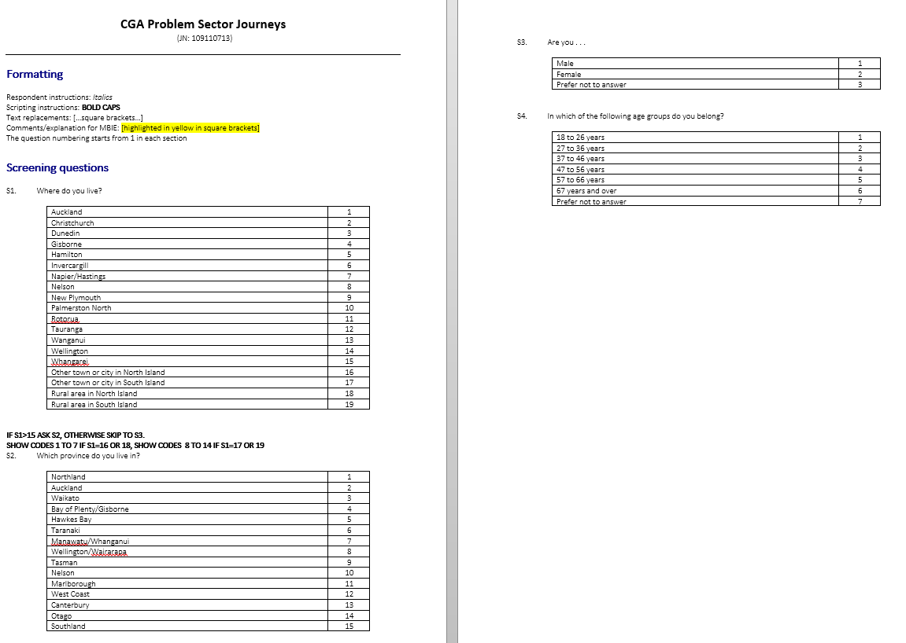

Slide 98
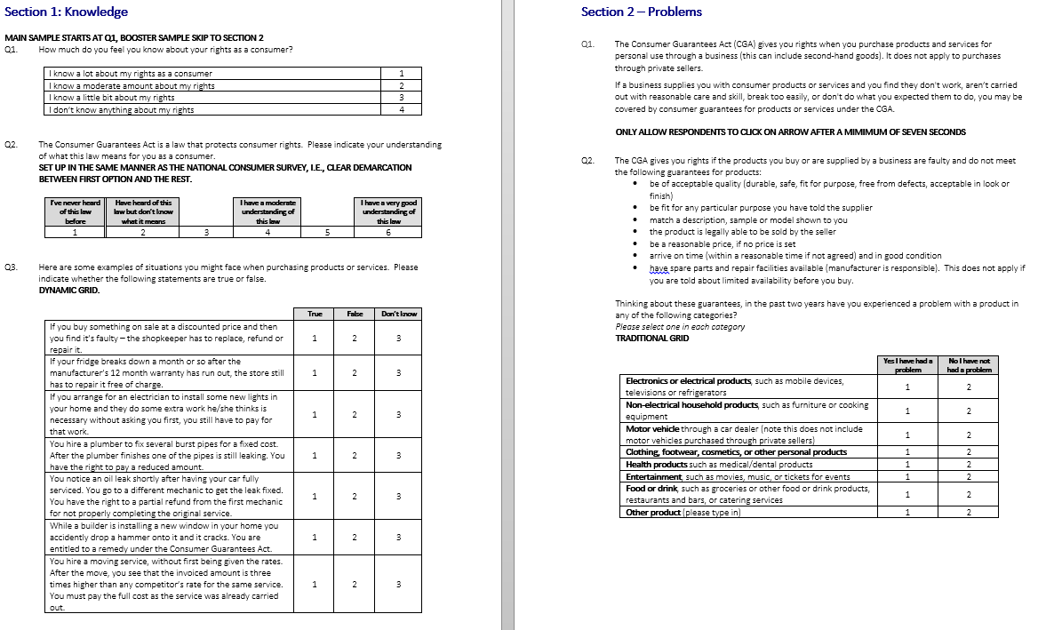

Slide 99
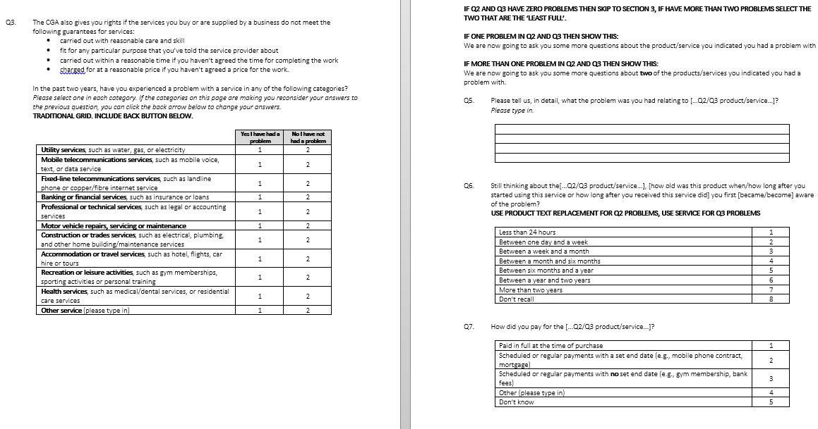

Slide 100
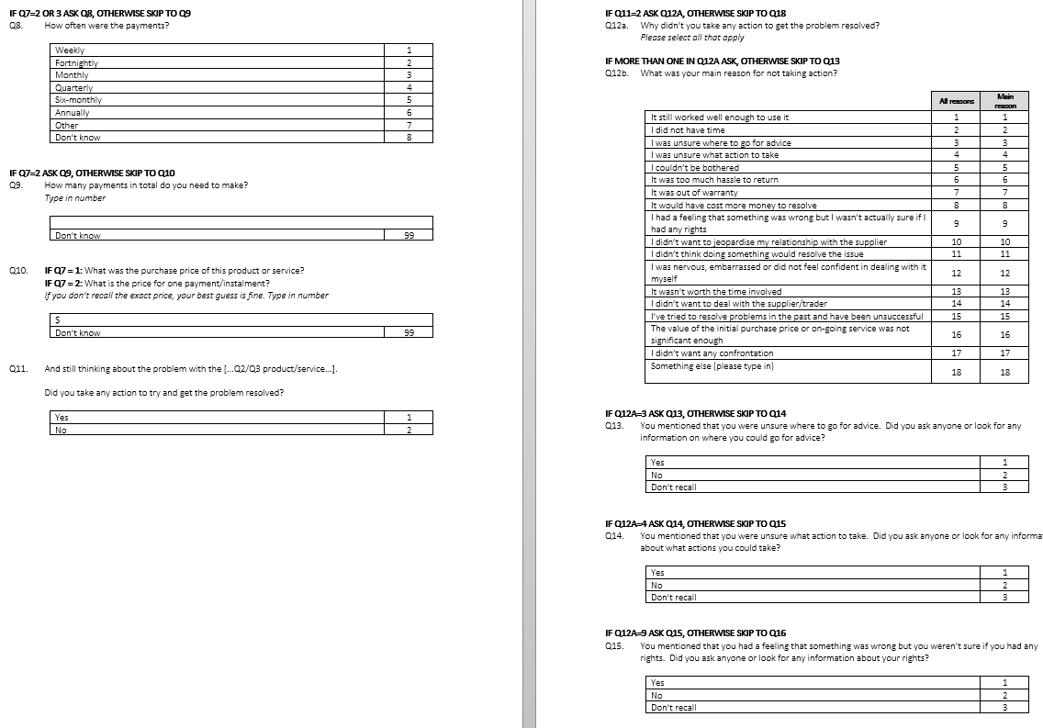

Slide 101
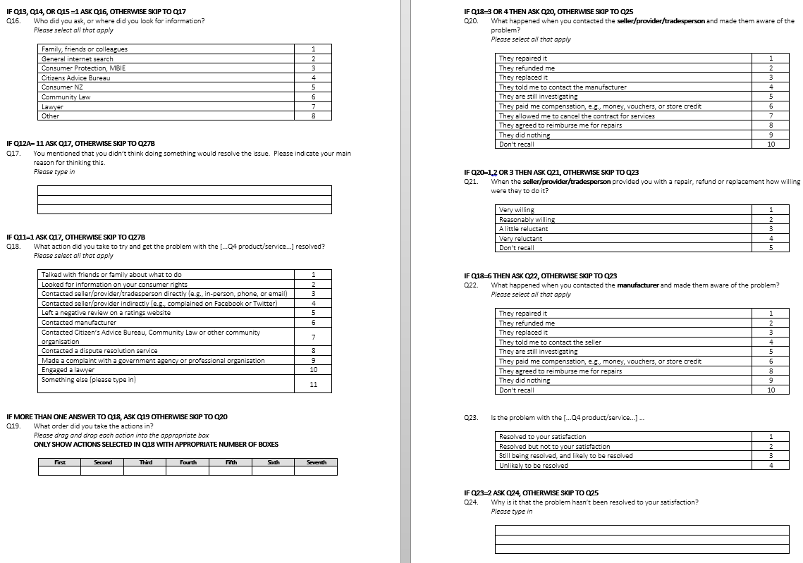

Slide 102
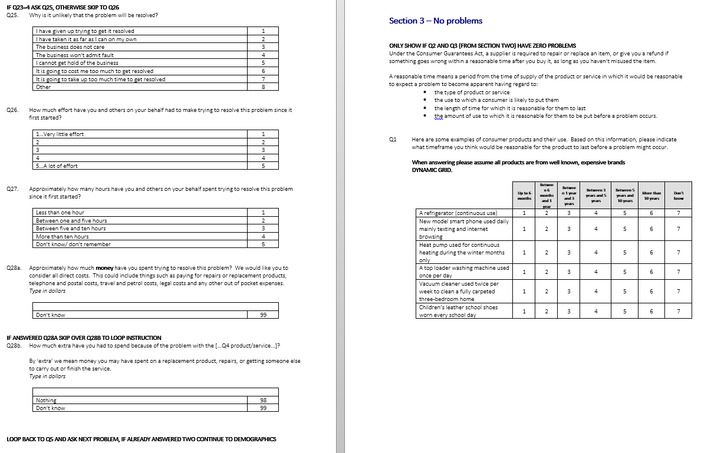

Slide 103
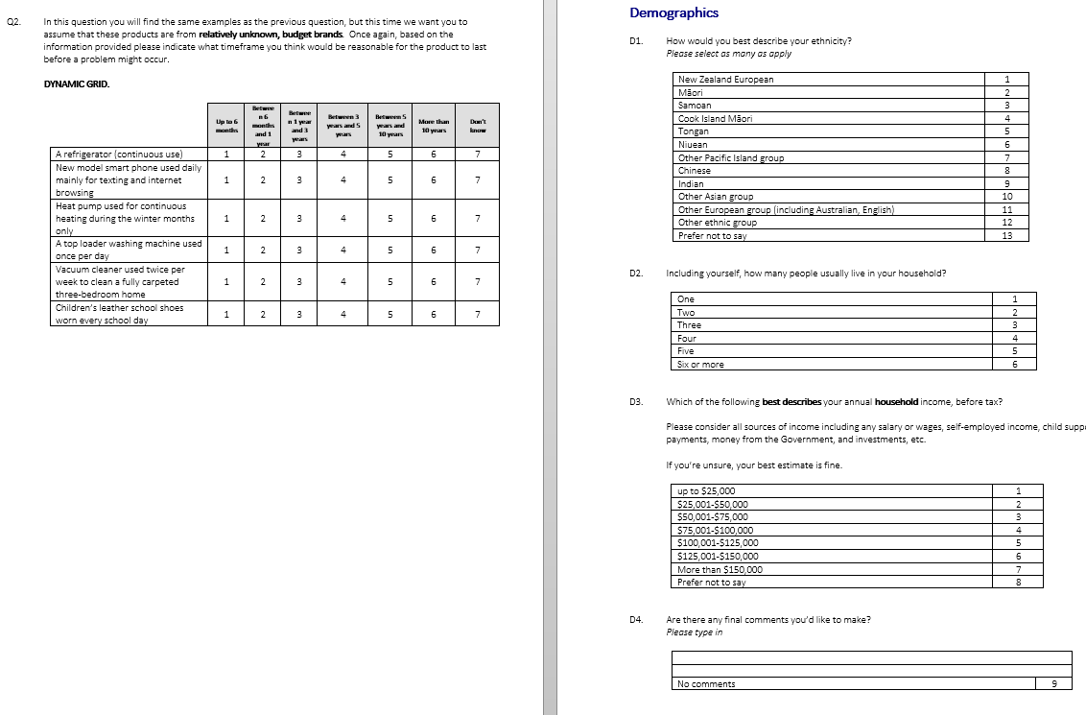

Slide 104
Appendix B: Sample profiles

Slide 105
Survey SAMPLE PROFILE
Percentages are weighted
 | TOTAL SAMPLE % | NATIONALLY REPRESENTATIVE SAMPLE (excludes booster of respondents who experienced a problem) % | EXPERIENCED A PROBLEM % | NOT EXPERIENCED A PROBLEM %
GENDER
Male | 46 | 48 | 45 | 51
Female | 54 | 52 | 55 | 49
AGE
18 to 26 | 13 | 16 | 14 | 11
27 to 36 | 16 | 16 | 18 | 10
37 to 46 | 19 | 18 | 19 | 16
47 to 56 | 19 | 18 | 18 | 22
57 to 66 | 15 | 15 | 15 | 15
67 and over | 17 | 16 | 16 | 25
 | TOTAL SAMPLE % | NATIONALLY REPRESENTATIVE SAMPLE (excludes booster of respondents who experienced a problem) % | EXPERIENCED A PROBLEM % | NOT EXPERIENCED A PROBLEM %
ETHNIC GROUP
NZ European | 79 | 78 | 80 | 78
Māori | 5 | 4 | 5 | 6
Pacific Island peoples | 2 | 2 | 2 | 2
Asian | 9 | 10 | 9 | 10
Other ethnicity | 10 | 10 | 11 | 9
HOUSEHOLD INCOME
Up to $50,000 | 22 | 22 | 21 | 26
$50,001 - $75,000 | 17 | 18 | 17 | 17
$75,001 - $100,000 | 16 | 16 | 17 | 12
$100,001 to $150,000 | 19 | 18 | 20 | 14
More than $150,000 | 9 | 7 | 9 | 6

Slide 106
Survey SAMPLE PROFILE CONTINUED
Percentages given are weighted
 | TOTAL SAMPLE % | NATIONALLY REPRESENTATIVE SAMPLE (excludes booster of respondents who experienced a problem) % | EXPERIENCED A PROBLEM % | NOT EXPERIENCED A PROBLEM %
LOCATION
Auckland | 33 | 33 | 33 | 31
Wellington | 9 | 9 | 9 | 9
Christchurch | 9 | 9 | 9 | 10
Rest of North Island | 35 | 34 | 34 | 37
Rest of South Island | 14 | 15 | 14 | 12
RURALITY
Main cities/towns | 79 | 79 | 79 | 78
Small cities/towns | 14 | 14 | 14 | 46
Rural | 7 | 7 | 7 | 6

Slide 107
QUALITATIVE RESPONDENT INFORMATION (INTERVIEWS)
GENDER | AGE | KNOWLEDGE | PROBLEM | ACTION | LOCALE
IN-DEPTH INTERVIEWS
F | 51-64 | Low | Banking / Financial Services | Took Action | Auckland
M | 66-70 | High | Banking / Financial Services | No Action, Obstructed | Auckland
M | 31 | Low | Legal Service / Lawyer | No Action, Obstructed | Auckland
F | 40 | Low | Medical (Dental) | No Action, Obstructed | Auckland
F | 36-50 | Moderate | Motor Vehicle Repair | No Action, Obstructed | Auckland
M | 21-35 | Low | Fixed Line Telecoms and Fibre Installation | Took Action | Wellington
TELEPHONE INTERVIEWS
M | 21-35 | Moderate | Internet Service Provider | Took Action, No Satisfaction | Auckland
M | 36-50 | Moderate | Fixed Line Telecoms | Took Action, Sought rights info | Gore
F | 36-50 | Moderate | Fixed Line Telecoms | Took Action, High Effort | Marlborough
F | 51-64 | Moderate | Travel | Took Action, High Effort | South Waikato
M | 21-35 | Moderate | Fixed Line Telecoms | Took Action, No Satisfaction | Tauranga
F | 36-50 | Low | Construction | Took Action, High Effort | Rangiora

Slide 108
QUALITATIVE RESPONDENT INFORMATION (WORKSHOPS)
GENDER | AGE | CHARACTERISTIC | PROBLEM | LOCALE
WORKSHOP 1: CONTRACTS
F | 21-35 | Action, Seller Non-responsive | Mobile service provider | Auckland
M | 65-69 | Action, Resolved, Not satisfied | Internet Service Provider | Auckland
M | 62 | Action, Satisfaction | Banking | Auckland
M | 35 | Action, Satisfaction | Internet Service Provider | Auckland
F | 53 | Action, Not satisfied | Internet Service Provider | Auckland
M | 28 | Action, , Not satisfied | Banking | Auckland
M | 28 | Action, Resolved, High Effort | Financial Services (Credit Card) | Auckland
F | 51-65 | Action, Resolved, High Effort | Fixed Telecom | Auckland
WORKSHOP 2: BUILDING
F | 48 | Action, Satisfaction | Maintenance | Auckland
F | 36-50 | Action, Resolved, High Effort | Renovation | Auckland
F | 36-50 | Action, Resolved, Not satisfied | Unrelated damage by provider | Auckland
M | 51-65 | Action, Resolved, Not satisfied | Renovation | Auckland
M | 70 | Action, Seller Non-responsive | Unrelated damage by provider | Auckland
M | 48 | Action, , High Effort | Construction | Auckland

Slide 109
Appendix C: Qualitative materials

Slide 110
STRUCTURE OF INTERVIEWS
IN-DEPTH
1. Introduction (Purpose: To introduce the research process) 2. Warm up and contextualisation (Purpose: To warm up participants and set the context for discussion) 3. Current behaviour and understanding (Purpose: To explore the top of mind perceptions and behaviour with regard to Consumer Rights, CGA) 4. Journey Mapping (Purpose: To document and understand the story: experiences, methods, sources, experiences – real action taken, reasons and feelings associated) 5. Motivations (Projection) (Purpose: To explore motivations, barriers and beliefs around engaging with consumer rights, CGA) 5. Behavioural insights (Purpose: To explore obstructions. To identify potential strategies to influence behaviour) 8. Summary (Purpose: To summarise thoughts)
TELEPHONE
1. Introduction (Purpose: To introduce the research process) 2. Warm up and contextualisation (Purpose: To warm up participants and set the context for discussion) 3. Journey Mapping Discussion (Purpose: To document and understand the story: experiences, methods, sources, experiences – real action taken, reasons and feelings associated. Probe around an IDEAL if time allows; REFER PRE-TASK) 4. Closure (Purpose: To summarise thoughts)

Slide 111
PROBLEM SECTOR WORKSHOPS
WORKSHOP STRUCTURE
1. Introduction & General Info 2. Warm up and contextualisation; sharing of individual stories 3. Present hypothesized journey of service issues (based on preceding interviews) 4. Discuss and re-create, challenge and refine with focus on their experiences in problem sector 5. Discussion of ideal (actions of individual, provider, other) 6. Final Review 7. Closing
HYPOTHESIZED JOURNEY FORMAT (SERVICES IN GENERAL)
ELEMENTS | STAGES
Needs | Awareness of Problem
Activities | First Contact & Submission of Issue
Expectations | Further Contact and Follow Up/s
Pain points | Escalation
Delights | Abandonment
Emotional State | Resolution

Slide 112
TELEPHONE INTERVIEW PRE-TASK TEMPLATE
 | WHAT SERVICE DID YOU PURCHASE? WHY DID YOU PURCHASE THIS SERVICE?(Please be specific) | WHO WAS THE SERVICE PROVIDER, WHY DID YOU SELECT THEM?
 | [enter text here] | [enter text here]
 | HOW DID YOU DECIDE ON THE SERVICE YOU WOULD PURCHASE & THE PROVIDER CHOSEN? | WHEN DID YOU REALISE SOMETHING WAS WRONG?
 | [enter text here] | [enter text here]
We would like more info about the service problem you shared in the recent survey. Please describe what happened before the purchase of the service…
WHERE DOES YOUR STORY START?

Slide 113
Thinking about the consumer problem you described on the previous page - please think of all the steps/actions you took once you identified you might have a consumer protection issue…
THE FIRST THING I DID WAS… |  | NEXT ACTION | NEXT ACTION | NEXT ACTION | NEXT ACTION | NEXT ACTION | THE END
What happened / what did you do? (the what, how and who) | [enter text here] | [enter text here] | [enter text here] | [enter text here] | [enter text here] | [enter text here] | [enter text here]
Why did you take that action? | [enter text here] | [enter text here] | [enter text here] | [enter text here] | [enter text here] | [enter text here] | [enter text here]
How did you feel at this point? | [enter text here] | [enter text here] | [enter text here] | [enter text here] | [enter text here] | [enter text here] | [enter text here]
Was this a high point or low point? | [enter text here] | [enter text here] | [enter text here] | [enter text here] | [enter text here] | [enter text here] | [enter text here]

Slide 114
 | [enter text here] | [enter text here]
 | [enter text here] | [enter text here]
ANYTHING ELSE TO SHARE?
THANK YOU

Slide 115
Appendix D: Consumer stories

Slide 116
1
Janice is a single mom with an amicable relationship with her ex-husband. When her car gave her trouble she asked for his help and he arranged what he called a ‘trade discount’ for her through a work contact. She was grateful for the special deal and happy to pay cash. Shortly thereafter she discovered further problems with the vehicle. She believed it to be as a result of damage caused by the mechanic who did not seem to have taken due care. She mentioned it to her ex-husband who encouraged her to go back. She did consider it but decided against taking any form of action.
She described feeling “too awkward” saying she had benefited from a ‘deal’ and it was through her ex-husband’s contacts so she considered the impact on him. She was mindful also of the inconvenience of being without her vehicle should they retain it for repair – the actual problem seemed minor compared to being left without transport for an extended period saying it would be too much a “life interruption”. She also feared what they might do to the vehicle if they perceived her negatively or if her return got anyone into trouble.
A further consideration was that she was really not knowledgeable enough about the car’s problem to attribute it with any certainty to their wrongdoing. Janice said that while she knows she has rights and has acted on her rights before in many instances (with other motor vehicle matters, in restaurants, etc), in this case she decided to let it be. She believed she would be unable to prove their lack of care/skill or even negligence in executing their work. This, coupled with her lack of knowledge about a car’s electronics, left her feeling like she should walk away saying she knew when to “pick a battle, and this wasn’t one”.
Janice was cross with the mechanic/s but also cross with herself. She regretted not having a better discussion with the mechanic/s before leaving her car with them and then leaving afterwards with nothing in writing. She felt that in future, if the problem with a vehicle is not severe, she would wait until she could afford it and pay for a fully guaranteed and professional service from a reputable provider.
JANICE’S
STORY

Slide 117
David had a family matter to resolve and needed legal expertise. It was complicated involving family across 2 countries and 2 languages and he recognised that it would require particular skill. He believed he did his research well, formulating a short list of 2 firms based on reviews in a trusted forum and on an interview he heard on the radio with the lawyer. After his initial contact things moved quickly, he met for a consultation and the prospects looked good. He paid the required fees and looked forward to speedy resolution. He felt confident and thought the fees reasonable and the process clear (in retrospect he thought perhaps slightly simplified and a bit too “high level”).
David described leaving the initial consultation positive and confident, and believed that the lawyer presenting a “worst case scenario” showed integrity. Within a few days the initial processes had begun and letters and documents were prepared and sent as expected. Then – silence…
David described growing worried. He was always initiating contact, making phone calls and checking in – only to have his calls unreturned or be given vague updates. Then he received a phone call saying they would be “unable to progress” and that it was “no longer feasible” to continue. He was given a small refund from the deposit. He felt disappointed and powerless – “there is nothing I could do”. They had made no progress, and he could not face the prospect of spending more time and money on another lawyer.
Taking further action did cross David’s mind. He did not consider that it would be a consumer protection issue but did wonder whether this was appropriate practice and professional conduct; he considered reporting the matter to a legal association / professional body of some kind. But this consideration was short lived. David described himself as “not that good with words” and felt that trying to build a compelling case against a lawyer – someone who did this every day – was a foolish undertaking. In addition he considered the amount of time it would take to generate the documentation, possibly attend a hearing and so on – and felt the time cost would be too high. Feeling like he was “already worse off” he decided that taking action would likely leave him in a worse position still.
David thought that in an ideal situation he would have gotten more clarity and asked more questions at the initial consultation. He wondered if getting referrals from real people he knows (rather than online and radio) would be better and thought that if he needed to use a lawyer again he would rely on first hand recommendation and proven reputation.
2
DAVID’S
STORY

Slide 118
3
A difficult family situation and an ailing mother in a wheelchair requiring care forced Sophia to make some difficult choices. Bringing her mother home from a care facility to live with her meant upheaval for her family and costly renovations to accommodate the wheel chair, but Sophia was determined that it had to be done.
Conscientiously, Sophia collected quotes to have her home made more wheelchair-friendly i.e. having ramps installed in her home as well as doorways widened. After selecting a contractor that was well priced and experienced she looked forward to the renovations which would make her life easier and her mother’s life more comfortable. A contract containing very specific detail of the task at hand (down to the angles of the ramps and the width of the doorways) was drafted and signed – something which Sophia insisted on having learnt the hard way from prior experiences that had left her “stung”.
With poor timekeeping and unreliability becoming hallmarks of his service, Sophia became increasingly concerned as to her choice of contractor. With various subcontractors appearing and disappearing, unfinished work all over the house and the job slipping behind schedule Sophia informed him that she would be withholding payment until everything was satisfactorily on track and that she was within her rights to do so. Some small actions on his part followed, at which point Sophia realised that the work had not been done correctly. The ramps were wrong and the dimensions of the doorways still too small for the wheelchair. It was effectively a deadlock as he refused to return to site to remedy until payment was made.
Sophia was left with a home that could not be secured and described sleeping in the lounge for months as a security precaution.
“I had to keep going” says Sophia, of the “painful” time describing how she felt angry but remained determined, confident in the contract and the specifics therein as evidence that the fault was his to remedy. She also armed herself with consumer protection information and kept meticulous record of every exchange and piece of paperwork. Without money to start the process anew and with the needs of her mother and state of her home as constant reminders, Sophia sought remedy from the Disputes Tribunal of New Zealand.
It was a long road but when it was resolved in her favour she felt joy and satisfaction.
SOPHIA’S
STORY

Slide 119
Sahil had reached the end of his contract with the ADSL provider at his home and shopped around online for a new contract. Knowing that there were many good offers and that it was very competitive, he was thoughtful about his choice and weighed and compared with care, his criteria included price per month, an unlimited offering and value adds on offer (e.g. limited time offers, special “bonuses” in the first month etc). He selected a large provider who met his needs at “the best price”. Signing up was easy and fully online, and after a confirmatory email the modem arrived via courier.
Within a month he started experiencing problems and his internet kept “dropping off”; a tedious and repetitive process of phone calls, telephone trouble shooting and hours on hold had begun. Feeling at first “annoyed” and eventually “furious” Sahil did “his bit” and followed instructions. Adding frustration was automation at the call centre and a lack of consistency in the tracking of his progress on the problem journey (e.g. being made to repeat trouble shooting steps over and over). When a technician finally came to Sahil’s home, on the date and time scheduled, he informed Sahil that there was “nothing wrong” with the line, and he couldn’t help.
Sahil called the provider determined to have the contract stopped and early termination charges waived as he believed he was paying for a service that was not being provided at all. He was further angered and disappointed when he was told to review his contract as there was no early termination without a fee. Determined to fight Sahil called again and again, insistent that there had to be a remedy and he was passed across the company eventually landing in ‘Retentions’, where he was told once again that he could not terminate without the costly fee. The ‘Retentions’ consultant suggested that Sahil upgrade to VDSL as this usually remedied the problem – which Sahil took to be an admission of their poor service offering and plainly disingenuous, which bolstered his resolve. However this was short-lived as every avenue he explored revealed that the contract took precedence and he had very little option, and that this VDSL upgrade proposal could not be considered as proof of anything. Through his work Sahil had learnt about the CGA, but after reviewing it online he felt he didn’t know “what to do with it” in this case. “I felt helpless” he said, adding “I accepted that I did what I could. I knew I could probably try to take them to court but that is too expensive and time consuming. They would bury me in paperwork. You know it will be more time and money than you have”.
So Sahil did his homework again - and put everything in place to terminate his contract in the fastest, most affordable way possible. He took some comfort in the fact that he had taken his business back and in so doing found resolution. Sahil felt that his understanding of the contract was not what he thought it was as he believed that early release in a case like his was possible. Sahil believes he will revise future contracts carefully with a focus on release and automatic renewals.
4
SAHIL’S
STORY

Slide 120
5
Alex is a single, young professional living with three of her friends in a flat. She went to Australia for a holiday and as a treat for herself, booked with one of the more expensive airlines and paid for the “full service” ticket that included better leg room, in-flight entertainment, and a meal. On her return flight back to New Zealand, she was assigned a seat with a broken entertainment system. Upon notifying the flight attendant, she was told that there were no other seats for her to be shifted to and that the airline was sorry for the inconvenience.
At the time, Alex did not press the matter as she didn’t want “to create a fuss and cause a scene” but was left feeling frustrated that she didn’t receive something that she had paid a premium price for. When she got home, Alexis decided to get in touch with the airline’s front office via email; she didn’t know about the CGA specifically but felt that she was “entitled to what I paid for” and drew confidence from the fact that she had clear records of her seat and flight number to send to the airline. At the same time, Alex felt that given the airline she flew with was well-known and reputable, they were bound to respond to her complaint and provide compensation.
The airline responded by offering Alex a considerable amount of air-miles that she could redeem with them the next time she flew. At this point, Alex felt justified in her decision to get in touch with the airline front office and happy that her complaint was looking likely to be resolved. However after the initial email from the airlines, Alex didn’t receive any further communications from them and did not see the promised air-miles appear in her frequent flier account. There was no reply despite repeated emails from Alex and her frustration mounted as time went on. She felt this was “typical” of big companies ignoring complaints in the hope they went away and felt determined to see this through and make a point that customers like her “couldn’t be pushed around”.
After four weeks of no reply, Alex decided to send one final email and managed to find the email address of a senior manager at the airline front office. She copied her into the email and received a reply within two days from the front office with confirmation that her air-miles had been added to her frequent flier account. Alex felt vindicated in her decision to pursue her complaint and draw the attention of a senior manager. She felt annoyed that she had to go through so much effort and decided that in the future, she would press the matter more forcefully when it happened rather than waiting. She also decided that she would contact a senior decision maker rather than email the standard complaints team as she felt the latter had no decision-making power and more often than not parked complaints while they were slowly escalated up the chain of command.
ALEX’S
STORY

Slide 121
Tim Hannan
&
Michael Dunne
Colmar Brunton
a Kantar Millward Brown Company
Level 9, Legal House,
101 Lambton Quay, Wellington
PO Box 3622, Wellington 6140
Phone (04) 913 3000
www.colmarbrunton.co.nz

